Slide 1
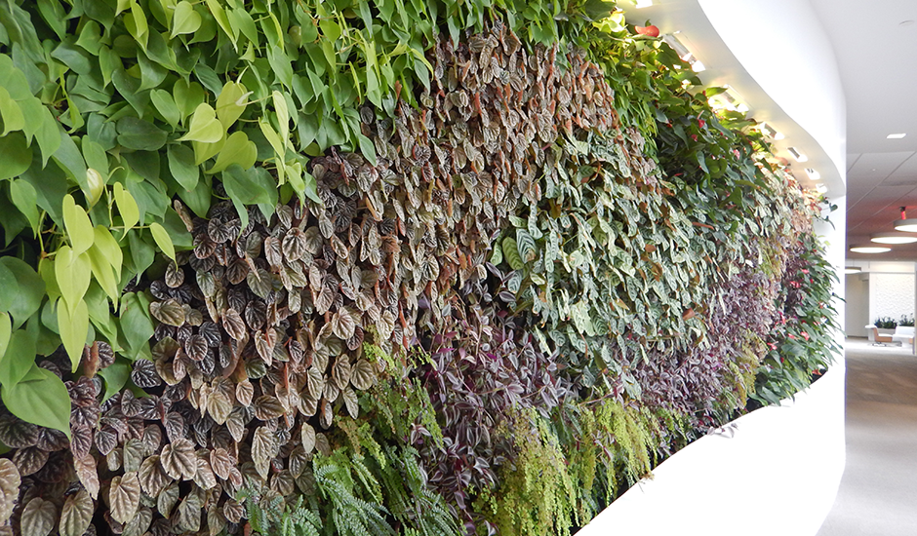
Living Walls with Case Studies
Photo: Furbish Co. BioWall Design Guide
Notes:
Hello, and thanks for downloading this information.
To support people and companies with a vision of the future in which preserving access to nature and interior landscaping is more relevant than ever, Green Plants for Green Buildings has created an edited version of our continuing education course, The Economics of Biophilic Design. It looks at the science behind the crucial role nature plays in maintaining our wellbeing, and includes research data from five sectors (education, health care, retail, workplace, and communities) on the impact biophilic design has on health, productivity and profits. We hope you’ll share this compelling information with your teams and create talking points for your client conversations.
Bear in mind: 1. This edited course is part of the GPGB Registered Trainer curriculum and is written as if you, the reader, are making this presentation. 2. This material will not confer to you Registered Trainer status. If you are interested in this, visit https://greenplantsforgreenbuildings.org/become-a-trainer/ for more information, or call us at 707-467-9417.
Be well and #StayPlanted!
Photo: Furbish Co. BioWall Design Guide

Slide 2
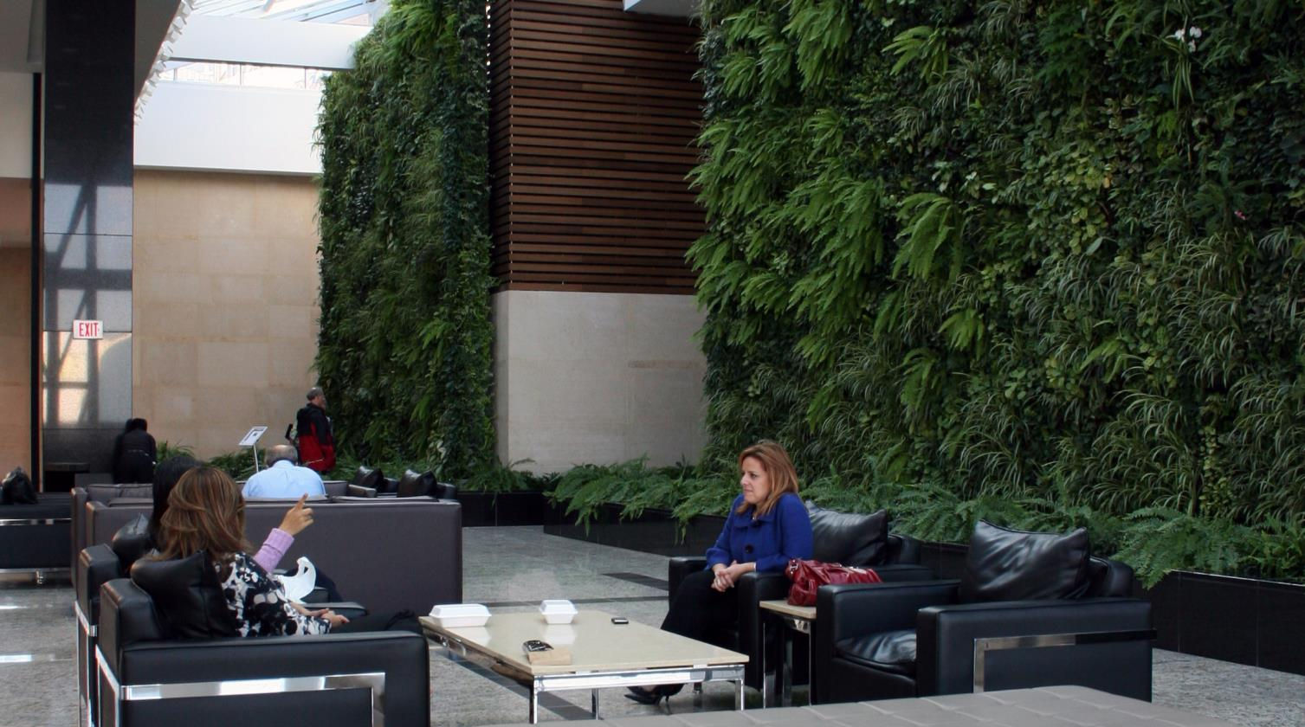
Course Description
This program gives participants an understanding of the use of different living walls systems both indoors and out, and in various climates. Attendees will discover the design considerations and positive effects of living walls on the built environment; and explore case studies of a variety of living walls systems and their performance after installation.
Photo Courtesy- McCaren Designs
Notes:
This program enables participants to gain an understanding of the use of different living walls systems both indoors and out, and in various climates. Attendees will discover the design considerations and positive effects of living walls on the built environment; and, explore case studies of a variety of living walls systems.
Photo: McCaren Designs, a Modular Hydroponic wall

Slide 3
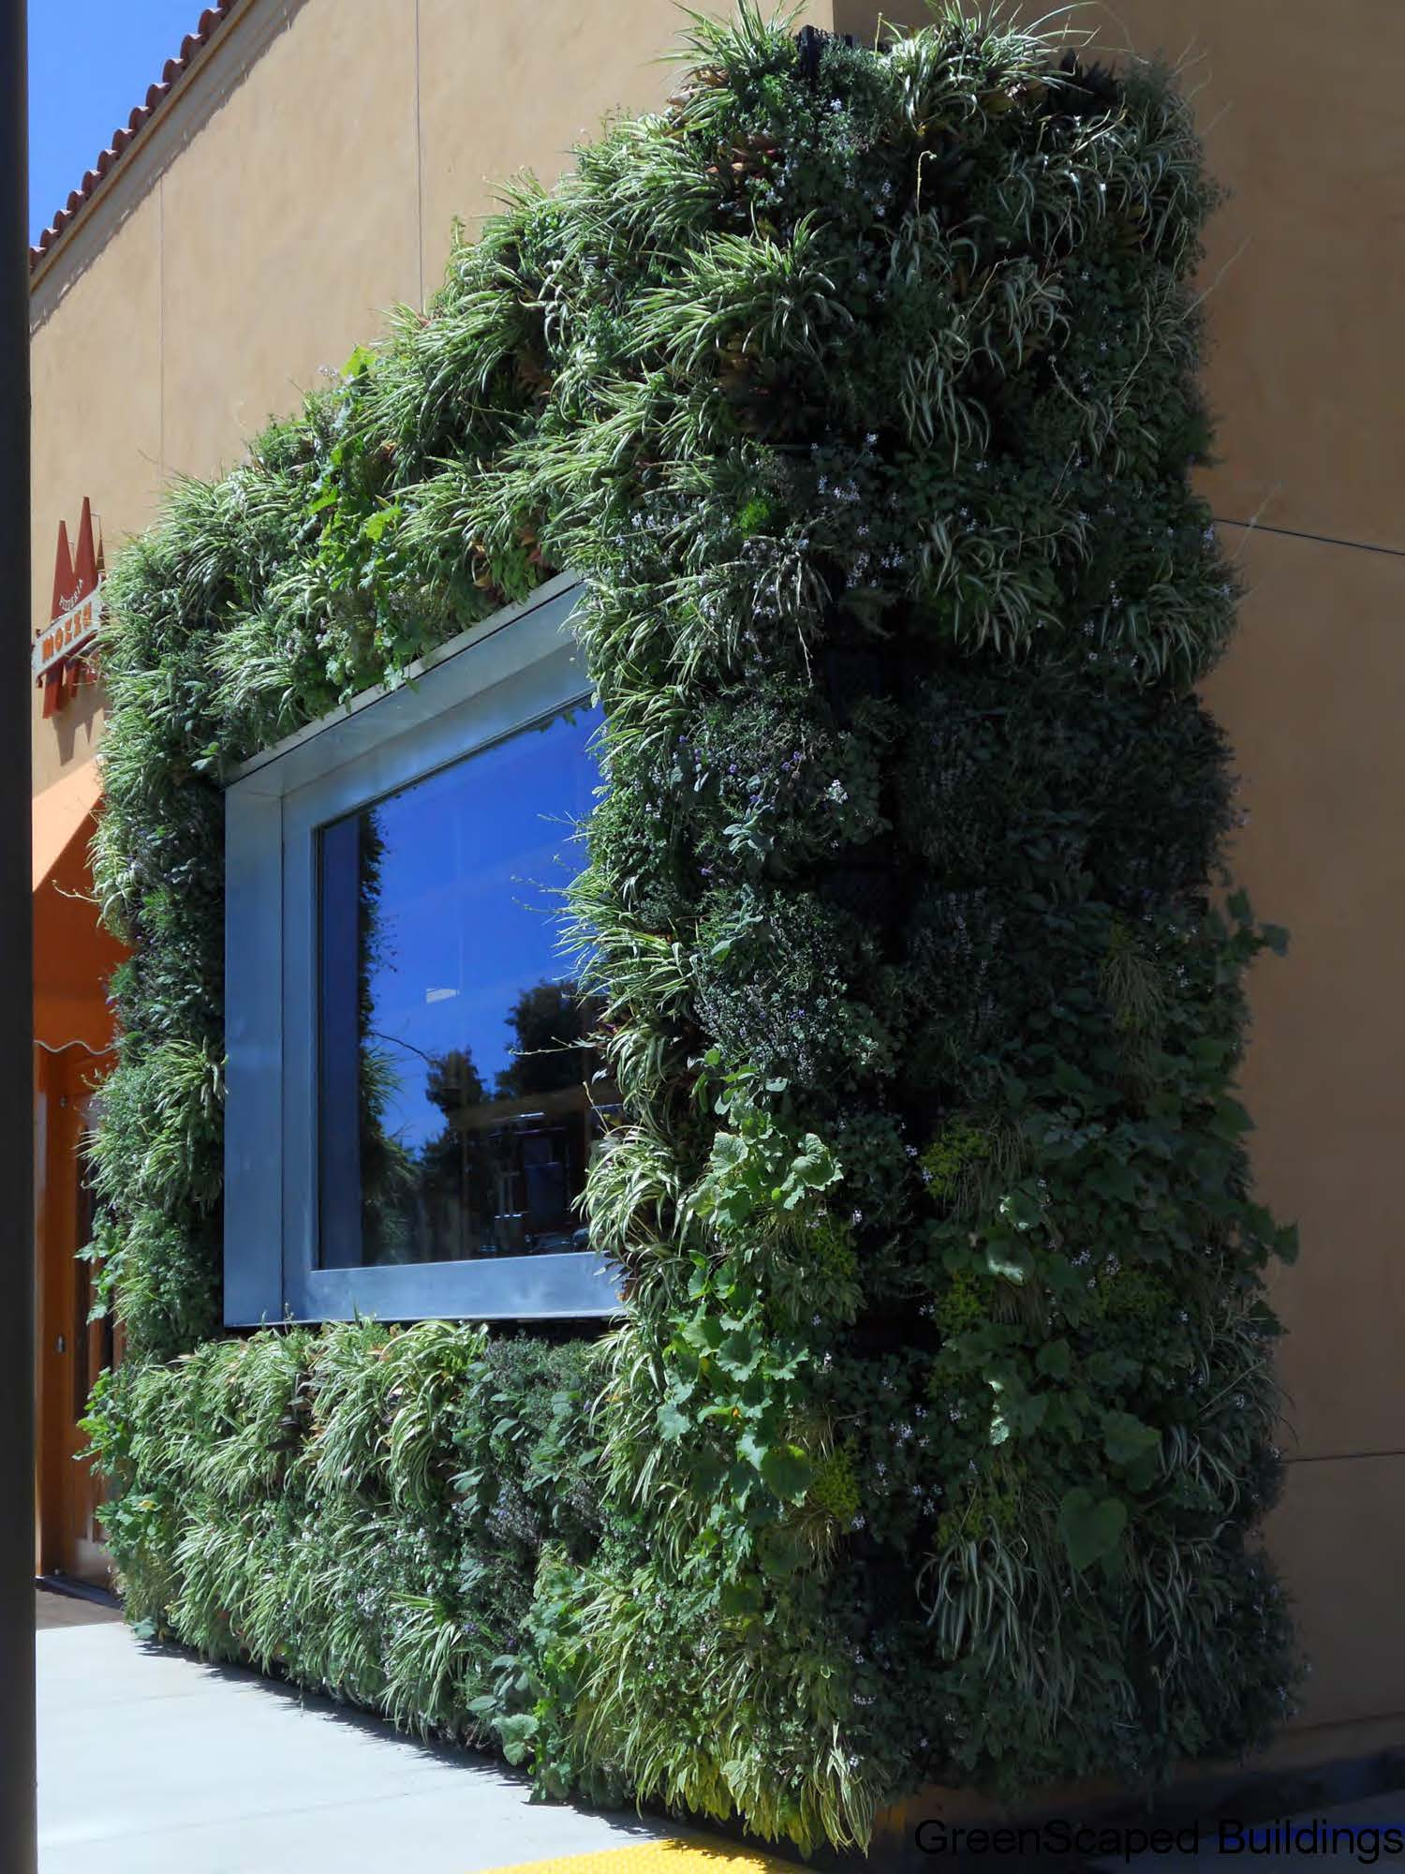
Copyright Materials
This presentation is protected by US and
International Copyright laws.
Reproduction, distribution, display and use
of the presentation
without written permission of
Green Plants for Green Buildings is prohibited.
© 2017 Green Plants for Green Buildings
Photo: Jim Mumford, GreenScaped Buildings
3
Notes:
This presentation is protected by US and International Copyright laws.
Green Plants for Green Buildings owns the copyrights for this program. At the end we’ll have copies of our white paper which covers most of the research you’ll find in today’s program, so be sure to pick up a copy on your way out.
Photo: Jim Mumford, GreenScaped Buildings, San Diego.

Slide 4
Learning Objectives
#1: Learn the distinguishing features of the various categories of living walls systems
#2: Understand design considerations including architectural, structural, mechanical, electrical, plumbing, lighting and horticultural.
#3: Learn the benefits of living wall systems on human wellbeing and productivity.
#4: Comprehend the best practices and approximate costs of the presented case studies.
Photo Courtesy- greenwalls.com
Notes:
Learning Objectives
Here’s what you’ll get from today’s program.
1: Learn the distinguishing features of the various categories of living walls systems.
2. Understand the design considerations including architectural, structural, mechanical, electrical, plumbing, lighting and horticultural.
3: Learn the benefits of living wall systems on human wellbeing and productivity.
4: Comprehend the best practices and approximate costs of the presented case studies.

Slide 5
What is a Green Wall, Living Wall, Vertical Garden?
Self-sufficient vertical gardens that are attached to the interior or exterior of a building.
They differ from green façades in that the roots of the plants are planted in a structural support which is fastened to the wall itself.
The plants receive water and nutrients from within the vertical support instead of from the ground.
Notes:
What is a Green Wall, also known as Living Wall or a Vertical Garden?
Green Walls are self-sufficient vertical gardens that are attached to the interior or exterior of a building. They differ from green façades in that the roots of the plants are planted in a structural support which is fastened to the wall itself. The plants receive water and nutrients from within the vertical support instead of from the ground.
They have been successfully adding value and beauty to interiors and exteriors around the world over the past 30 years.

Slide 6
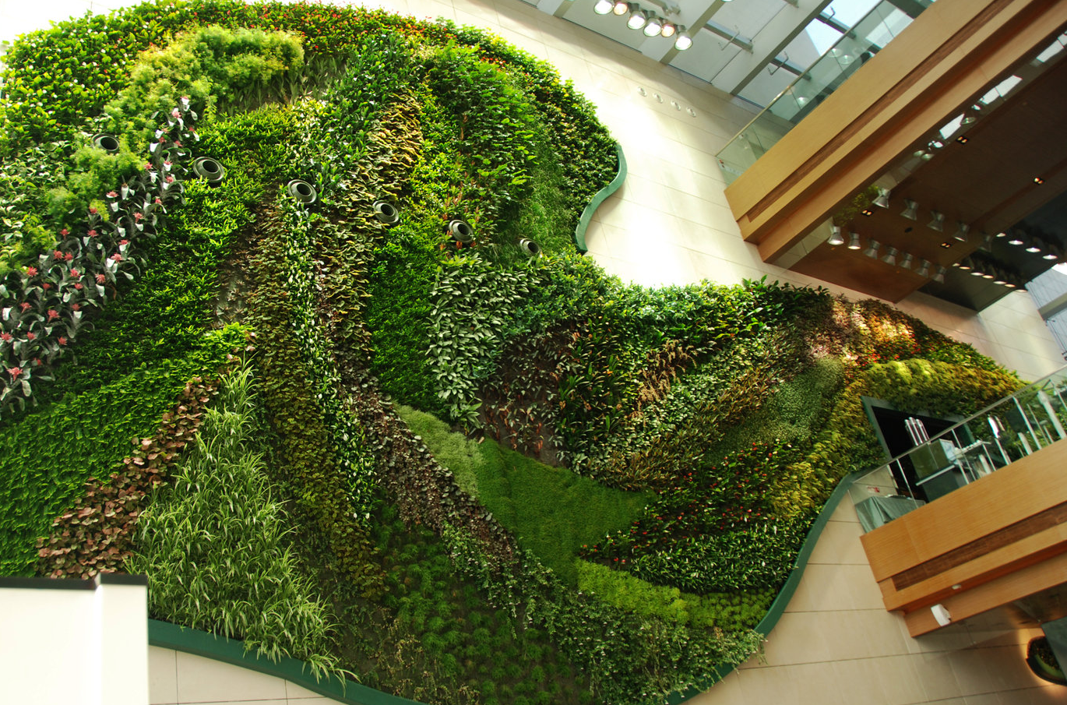
Pioneers
Prof. Stanley Hart White,
Landscape Architecture Dept.
University of Illinois, 1938
Patrick Blanc, Vertical Gardens
French Botanist
First installation in 1988
Photo Courtesy- verticalgardenpatrickblanc.com
Notes:
The first green wall system of modern times were called “botanical bricks” and were invented by Professor Stanley Hart White of the University of Illinois in 1938. However, they did not become popular until Patrick Blanc, often considered the “father of the green wall” designed his first vertical garden in 1988 for the Museum of Science and Industry in Paris. His wall shown here is the Icon Hotel, Hong Kong Polytechnic University. His designs were so innovative that he quickly became world-renowned for his green walls and they have become increasingly more popular ever since.
In this slide, note the banks of lights that provide optimal light for plant health.

Slide 7
Types of Walls and Wall Systems
Fixed Hydroponic
Bio-filtration Hydroponic
Modular Hydroponic
Engineered Modular
Vertical Display
Planted Pockets
Trellised
Moss Walls
Mixed Media Walls
Photo Courtesy: McCaren Designs.
Notes:
This next section will give you an overview of some types of living walls.
More types of systems are being developed every year but these are some of the major categories.
Fixed Hydroponic
Bio-filtration Hydroponic
Modular Hydroponic
Engineered Modular
Vertical Display
Planted Pockets
Trellised
Moss Walls
Mixed Media Walls
This is a mixed media wall by McCaren Designs.

Slide 8
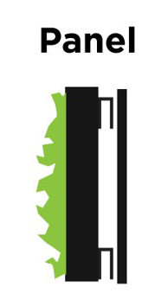
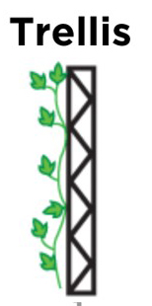
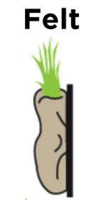
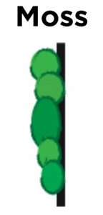
Overview: Systems
Aka ‘Module’. Plants are removed from their pots and planted into panels.
Tray systems hold the potted plants and water.
A variant of on a tray system.
Plants are removed from their pots and planted into pouches.
Plants are removed from their pots and planted into holes cut into a single piece of fabric.
Plants are planted in the ground, irrigated with a ground system and trained up the trellis.
Preserved moss is attached to a substrate. An option when live material is not feasible.
Notes:
OVERVIEW: SYSTEMS. One of the first challenges is choosing the right system for the specific project
These are just seven, there are well over 40 different manufacturers making living wall systems
Some of the questions to ask:
Is the project commercial or residential?
Inside or outside?
Budget?
Installation lead time? – Some systems require 3-4 months to grow in advance.

Slide 9
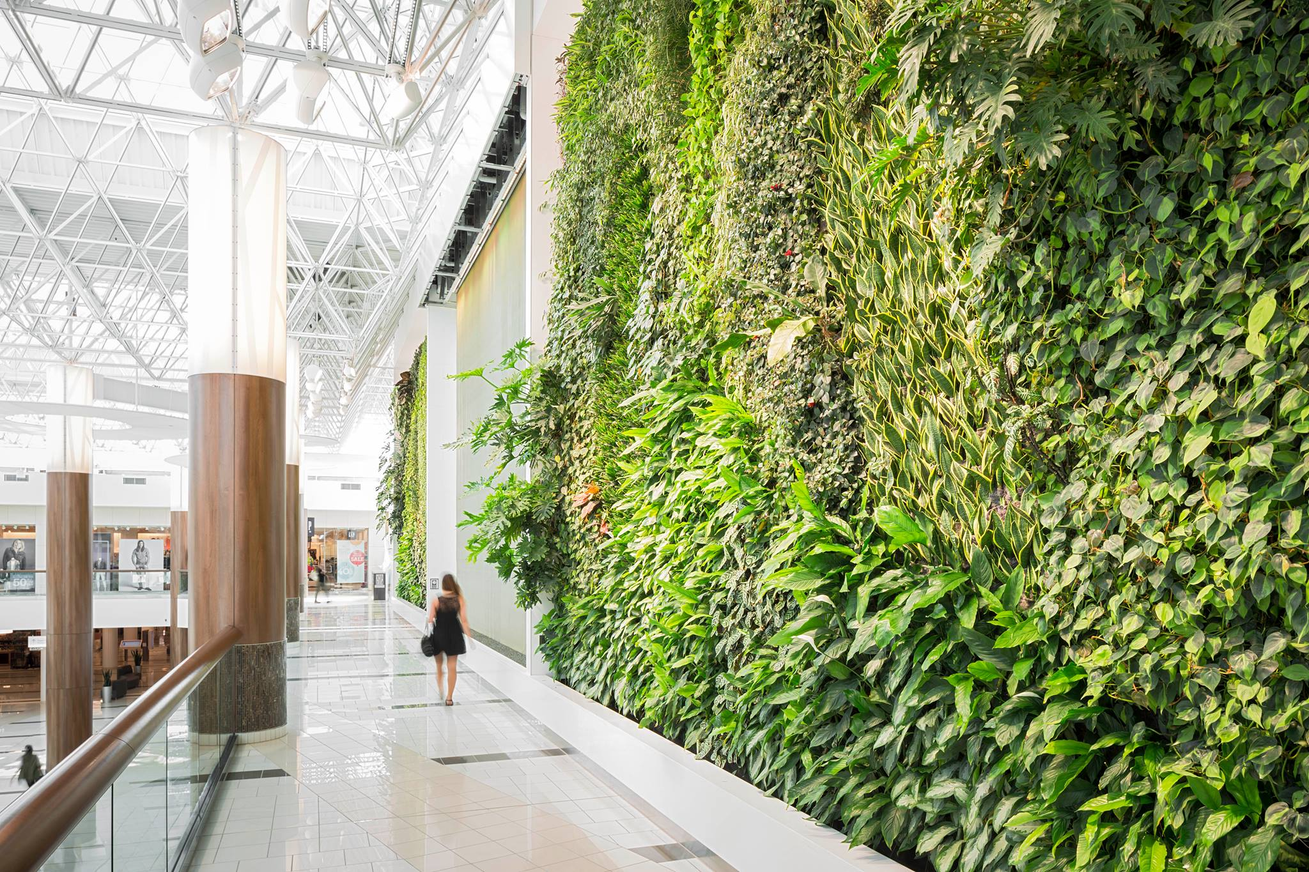
Overview: Components
PLANTING MEDIA:
Soil, hydroponic
IRRIGATION SYSTEM:
May be constant, by hand, or by drip
STRUCTURAL SUPPORT:
May be attached directly to the subsurface or attached to a grid
DRAINAGE:
Catch basin, gutter or base plantings
Guildord Town Center
British Columbia Canada
Green Over Grey
Notes:
OVERVIEW: COMPONENTS
Planting media: Depending upon the system this could be Soil, or Rock Wool or Fabric or Foam.
Irrigation: Primarily drip or manual which moves through the wall by gravity. This could happen mechanically with an controlled irrigation or by hand, for example a pot rack system irrigated by hand with a portable water tank.
Structural support: Attached directly to the subsurface, or attached to a grid.
Drainage: With the exception of a hydroponic system, living walls are designed to use a minimal amount of water.
If the system design is plumbed to a point of connection, there must be adequate drainage. A catch basin is used to re-circulate captured water which is monitored for fertilizer, salinity and ph. This water can spread disease so the catch basin water must be changed every other month.
Note the great natural and supplemental lighting for this installation.
Photo courtesy: Green Over Grey, Guildord Town Center, British Columbia Canada

Slide 10
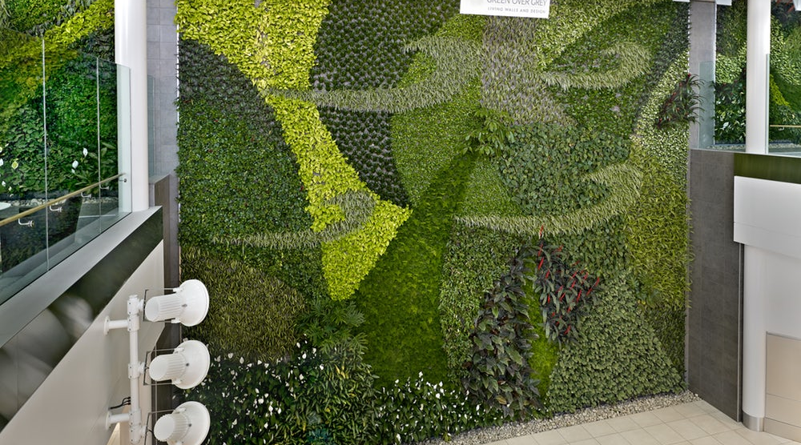
Fixed Hydroponic
Edmonton International Airport; Green Over Grey, 2012
Notes:
With this system, essentially two layers of fabric are attached to a waterproof support; the outer layer holds the plants, the inner layer holds the water.
Features:
Lightweight.
Allows for a large variety of planting options.
Plants with little or no soil are placed in pockets attached to a support structure.
The roots become interwoven with the hydroponic media.
Irrigated from the top of the wall, but very dependent upon regular irrigation and nutrients.
Must incorporate a catch basin and re-circulation system.
These walls are more expensive and generally range from $90- $150 sq/ft installed.
Photo courtesy of Green Over Grey, Edmonton International Airport

Slide 11
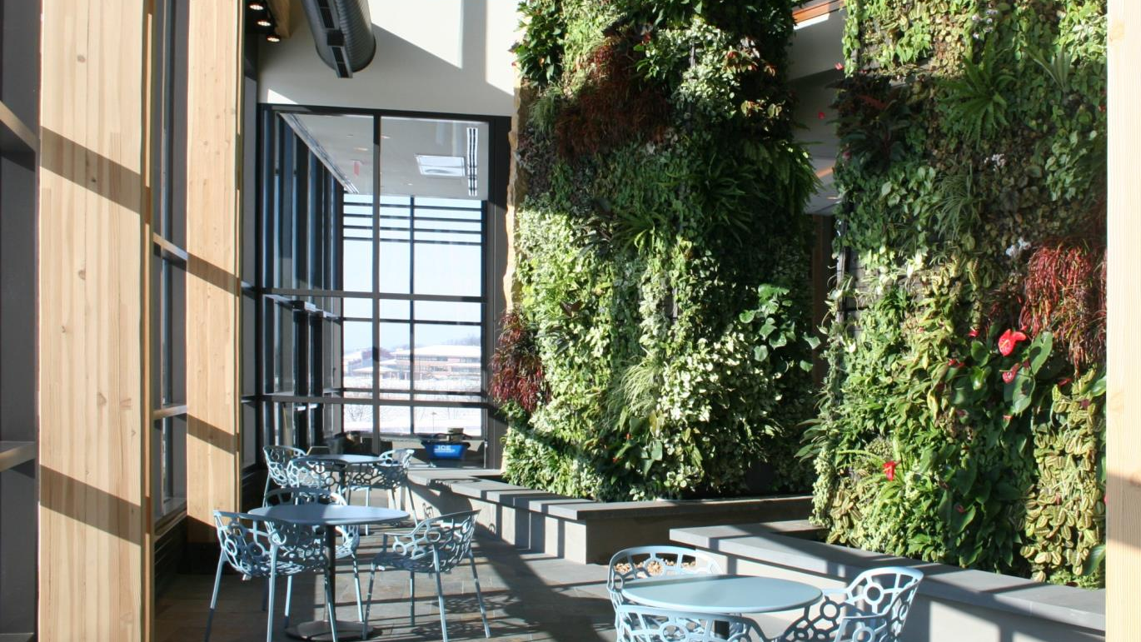
Modular Hydroponic
Photo: McCaren Designs
Notes:
This system uses a long-lasting, lightweight planting medium (open cell polyester polyurethane foam) that is not subject to deterioration through decomposition. Provides protection of the structural support.
Features:
Lightweight.
Used in indoor use or protected sites only
Allows for a large variety of planting options.
This system differs from Fixed Hydroponics in that the plants are placed in hydroponic growth media modules and then attached to a support structure.
The roots become interwoven with the hydroponic media.
Irrigated from the top of the wall, and as with Fixed Hydroponic Walls, are very dependent upon regular irrigation and nutrients.
These walls are generally more expensive than fixed hydroponics and range from $100 - $175 sq/ft installed.
Photo courtesy: McCaren Designs.

Slide 12
Bio-filtration Hydroponic
Photo Courtesy: Parker Interior Plantscape
Notes:
This sophisticated hydroponic system creates an ideal environment for plant growth. The growth media is not subdivided into small sections (pots or modules) thus allowing extensive root growth. This also allows to use of larger sized plants.
The Bio Wall System actively draws air through the root zone to degrade airborne contaminants, volatile organic compounds (VOC’s) such as benzene, formaldehyde and other chemicals in the air. Cleaning the air with the bio filter can use 80% less energy than traditional ventilation systems
Features:
A highly specialized fixed hydroponic wall.
Requires catch basin and irrigation re-circulation system.
Allows for a large variety of planting options.
Plants are placed in hydroponic growth media are attached to a support structure and integrated with the building’s HVAC system. Air is pulled through the root zone.
These walls are the most expensive and generally range from $250-$300 sq/ft installed.
Photo: Drexel University, Philadelphia, PA. This system in this photo is manufactured by Nedlaw. Installed by Parker Interior Plantscapes, New Jersey.

Slide 13
Planted Pockets
Photo Courtesy:
Woolly Pockets
Notes:
In this system, lots of drip irrigation keeps the root balls moist. These walls are planted on-site, root balls are wrapped in felt and inserted into the pockets.
Features:
Fiber plant pockets are mounted on a wall.
Interior and exterior products are available.
Soil and plants are placed into the pockets.
Generally a less expensive option: $65-$95 per sq. ft., installed.
Wide range of plants are adaptable.
Maintenance is similar to potted plants.
Image Shown is the Florafelt System

Slide 14
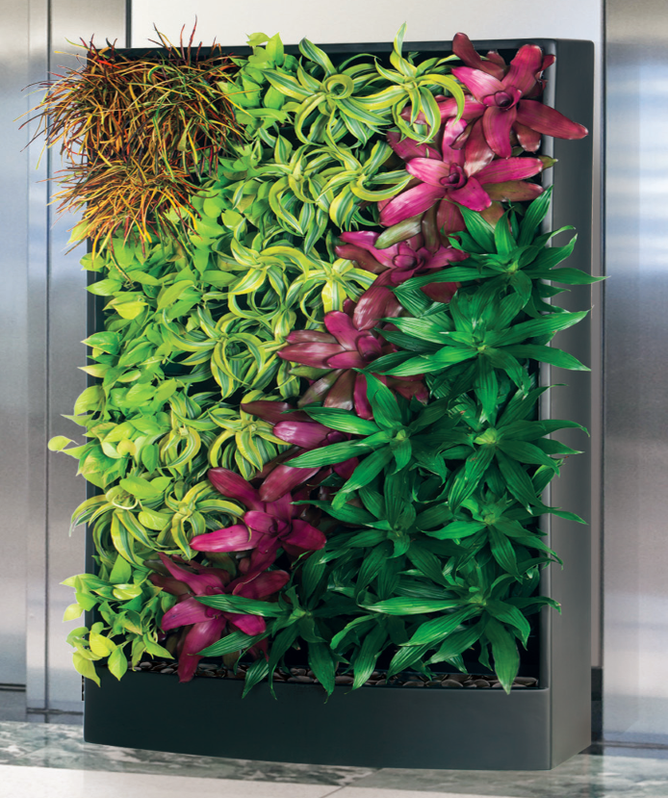
Vertical Displays
0
Vertical Displays
Photo Courtesy: Architectural Supplements
Notes:
Vertical Display Features: These systems typically use grids to support potted plants. Many of these systems are free-standing – they are not attached to a wall, are hand irrigated with a catch basin. These systems are useful in implementing physical distancing measures.
Plants are placed in pot holding system.
Typically can be installed immediately – do not require a grow-in period.
In general is a moderately expensive option: $75 - $125 per sq. ft., installed.
Allows for easy plant rotations (such as blooming or seasonal change outs).
Easy to install. Removable trays for easy cleaning. Wick/ Reservoir System creates a 2-4 week water reservoir with easy plant installation and quick plant replacement, can be self contained for watering.
Indoor, Outdoor and seasonal display
How is it planted: 6” plants from any of 100’s of growers, with a very large assortment of varieties are always available. Simply insert the Rigid Capillary Sipper Wick into the bottom drainage hole of the grow pot and place into the 30 Degree angled Planter Tray.
Note the irrigation catch-basin at the bottom of the unit. This is system is made by Architectural Supplements.

Slide 15
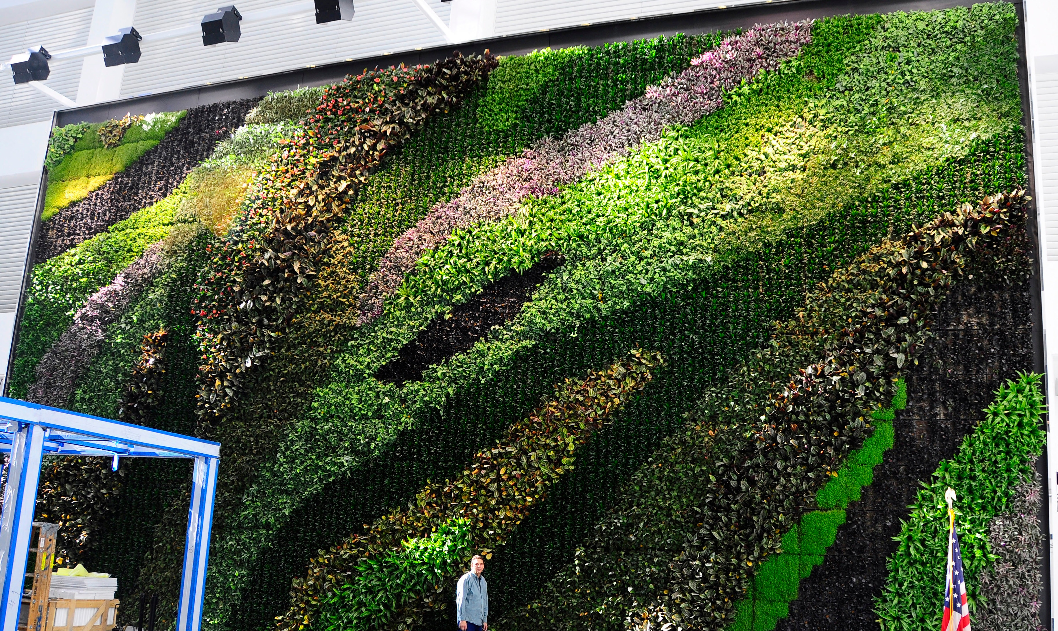
Engineered Modular
15
Photo Courtesy:
Plant Connection
Notes:
Features of the Engineered Modular system:
Modules (panels) are planted with plants in growing media.
Weighs around 20-25 lbs per sq. ft. Support can be complex and expensive.
An excellent system for highly designed walls.
Irrigation is more difficult; susceptible to wet and dry spots.
Typically has a pre-installation period of three months when plants are growing in the nursery.
A more expensive option: $150-$200 per sq. ft., installed.
This installation is located at BNY Mellon Bank, Barclay Street, NYC. This G-O2, soil-based living wall system is 60 feet wide by 32 feet tall (1920 square feet) in a 33-story atrium.
It is designed by Sabrina Buttitta and installed by Plant Connection in collaboration with Gensler Architects. It is maintained by Parker Interior Plantscape and it utilizes a remote monitoring system. 12 sensors in the wall take temperature, soil moisture and soil salinity readings 24 hours a day, 7 days a week. That information is transmitted to a central computer server where it is interpreted in a specifically designed software platform that is accessible by maintenance team Alerts can be sent to smart phones or via email whenever the wall is out of the safe parameters for temperature, soil moisture or salinity that we have set in advance.

Slide 16
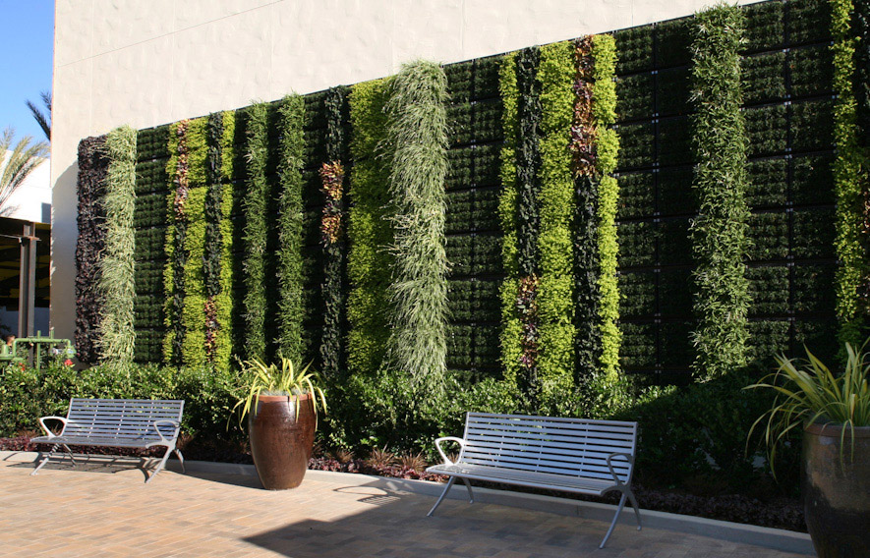
Engineered Modular - Exterior
16
Notes:
For an exterior engineered modular wall, the design considerations are like those for an interior engineered modular wall, plus plant selection considerations due to climate (temperature, wind, weather).
This is a Tournesol Siteworks (VGM) Green Wall, installed by Good Earth Plants of San Diego at Fashion Valley Mall in San Diego, California.

Slide 17
Trellised Walls
Photo Courtesy: McCaren Designs.
Notes:
Features: These systems use grids or cables to support climbing plants on a tellis, wall, panel or column.
Plants are placed at grade. (in the ground)
Takes time to grow and cover the space.
Is a good type of system for curbing heat gain in an exterior application.
In general is the least expensive option, $50-$75 sq/ft installed.
Allows for expanding the planting options to include vines and climbing.
Photo credit is McCaren Designs.

Slide 18
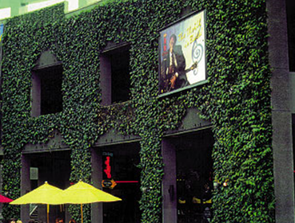
Trellised
Walls
Photo: GreenScreen at Universal Studios, CA.
Notes:
Photo: GreenScreen at Universal Studios, CA.
A word about many trellised walls: ever years after installation and time spent growing in, it is very difficult to get full coverage.

Slide 19
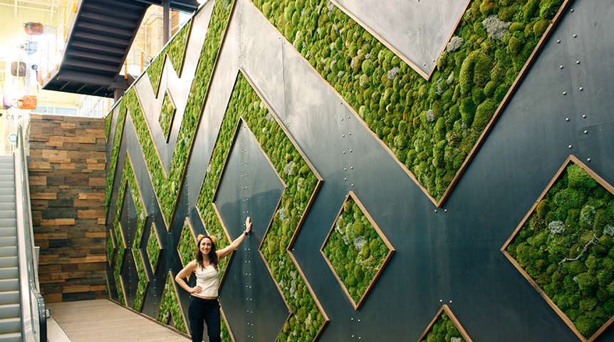
Moss Walls
Photo: Monique Capanelli,
Whole Foods, Austin, TX
Notes:
These walls are used to expose us to nature when live plants cannot be grown or maintained due to structural, environmental or maintenance limitations.
Features:
Most commonly made of preserved and dyed lichen.
Highly customizable in size and shape.
A variety of design materials can be incorporated (branches, shells, digital displays, etc.)
Require no water or sunlight.
Maintenance is still required.
Do not attract dust.
Cost range is varies with design.
Photo: Monique Capanelli, Whole Foods, Austin, TX

Slide 20
Benefits
Conserves valuable floor space while incorporating the benefits of Biophilic Design
Aesthetic
Economic
Wellbeing & Health
Photo Courtesy: Green over Grey
Notes:
Let’s talk a moment about the benefits of installing living walls.
Why consider a living wall?
The first answer is that they do an excellent job of bringing nature indoors and incorporating biophilia into our interiors. More about why we need this in the next slides.
The second is that square footage is a valuable commodity and vertical walls allow for that real estate to stay in the productive uses that the office, restaurant, retail store, etc. has already established.

Slide 21
Biophilia
Innate human attraction to nature.
Notes:
Biophilia when translated from Latin means “love of life or living systems”.
Biophilia as a hypothesis was first expressed by German social psychologist Erich Fromm in 1964 and later popularized by American biologist EO Wilson, in his 1984 publication ‘Biophilia’.
Wilson’s description was “Biophilia is the innately emotional affinity human beings have for other living organisms. Innate means hereditary and hence part of ultimate human nature.” – E.O Wilson
Over the last three decades the scientific and design communities have begun to recognize biophilia and perform experiments designed to prove or disprove the hypothesis. And the research evidence is flooding in. Scientists are proving the biophilia theory.
And this makes such sense! Humanity has spent 95% of its evolutionary history in the embrace of the natural environment. We are hardwired to respond to the stimuli of our natural surroundings.
Biophilia implies that humans hold a biological need for connecting with nature on physical, mental, and social levels, and that this connection affects our personal well-being, productivity, and societal relationships.
This biophilic design information in this presentation is based on Terrapin Bright Green’s The Economics of Biophilia. Research citations and calculations mentioned in this presentation appear on pages 29 – 39 of their publication.
Download a copy from https://greenplantsforgreenbuildings.org/research .
Photo: Istock

Slide 22
How Does Biophilia Affect Us?
Interaction with nature is essential in regulating the autonomic nervous system integrating the mind and body.
Sympathetic system controls cognitive function
Parasympathetic system controls relaxation
CASE STUDIES CONCLUSIONS – Access to nature
Decreases stress and irritability
Increases concentration
Notes:
This is a really chewy topic. The short 1-minute summary is this:
The stressful, chaotic, noisy environments we experience every day are causing an increase in the activity of our sympathetic nervous system. The causes mental fatigue, frustration, irritability and distraction. It stimulates the fight or flight response.
The remedy is provided by our parasympathetic nervous system, which works to relax the body.
Interactions with nature increase the activity of the parasympathic nervous system by 56%.
So stress goes down and concentration increases ☺

Slide 23
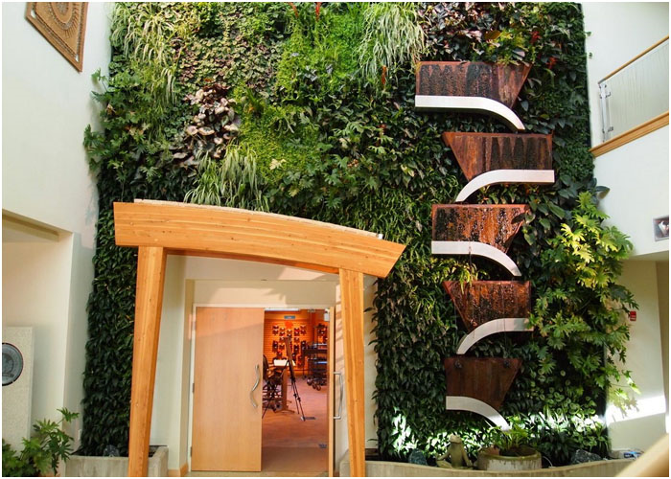
Nature Has Profound Economic Benefits
Find the research citations at https://greenplantsforgreenbuildings.org/resources/
peer-reviewed/
Photo: Dansko headquarters, Philadelphia, PA.
System: Furbish Co. BioWall
Notes:
What does all this mean for building and business owners? It means that nature is not just a nice amenity, nature has profound economic benefits.
As it applies to the workplace, in 2010 the US Department of Labor reported an annual absenteeism rate of 3% per employee, or nearly 63 hours per year per employee. A 2011 study identified a correlation in architectural elements with 10% change in the number of sick leave days taken. The quality of a person’s view concluded to be the primary predictor of absenteeism. In the workplace, research has shown that the cost for termination, replacement and productivity loss can be as much as $25,000 per employee. Plants can and do help.
In the health care sector, over fifty studies have been published that associate biophilic elements as the primary influences for faster recovery rates for patients, decreased dependency on medication, reduced staff and family stress, and improved emotional wellness. By reducing the average length of stay in hospitals by just .41 days, $93 million dollars in costs can be saved every year.
Research citations are in The Living Walls White Paper provided for you today and on pages 29-39 of Terrapin Bright Green’s publication The Economics of Biophilia.
"Terrapin Bright Green, The Economics of Biophilia".
Photo: Dansko headquarters, Philadelphia, PA. System: Furbish Co. BioWall

Slide 24
Benefits – Biophilic Design
CASE STUDIES OF ECONOMIC BENEFITS ACROSS FIVE INDUSTRY SECTORS
Workplace
Health Care Facilities
Retail
Education, K-12 and higher education
Communities
Notes:
While we may not be consciously aware of it, biophilia acts upon us in our everyday lives. At work, after photos of family, friends and pets, plants are the item most frequently used to personalize workspaces.
This innate affinity for life provides opportunities for building owners, designers, architects, facilities managers, plantscapers and horticulturalists to create environments which elicit positive responses from tenants, shoppers, workers, patients, students and others.
The infographic on this and the following slide illustrate the research results on the effects of biophilia in the workplace.

Slide 25
Benefits – Biophilic Design
CASE STUDIES OF ECONOMIC BENEFITS ACROSS FIVE INDUSTRY SECTORS
Workplace
Health Care Facilities
Retail
Education, K-12 and higher education
Communities
Notes:
Hundreds of studies have been done that indicate the same positive affects in other industry sectors.
Research citations are in The Living Walls White Paper provided for you today and on pages 29-39 of Terrapin Bright Green’s publication The Economics of Biophilia.

Slide 26
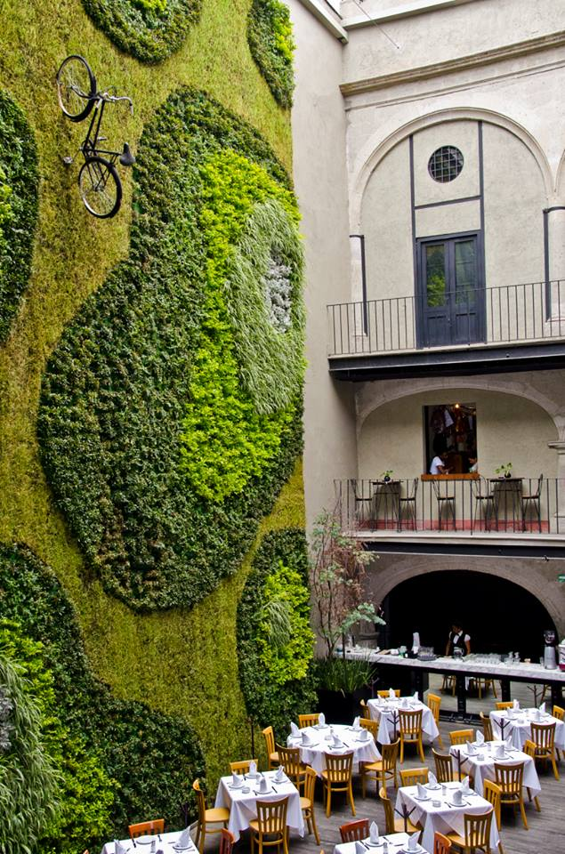
Benefits – Living Walls
Reduced occupant stress
Ambience, Wellbeing, Art
Natural air filtration and VOC removal
Noise abatement
Thermal regulation
Reduced Heat Island Effect
Conserves valuable floor space
Notes:
Why Living Walls?
They’re beautiful! Living art and an esthetically pleasing environment enhance mental health and wellbeing.
They increase human comfort which results in reduced occupant stress and increased productivity.
Living Walls “enliven” in several ways- Environmentally and economically. You’ve just heard about some of the economic benefits.
Environmentally -
Cleaner Air Quality – they, especially their roots, absorbs CO2 and Volatile Organic Compounds (VOC’s), they produce oxygen
Plants increase the ambient relative humidity through evapo transpiration. The thermal regulation they provide reduces wear and tear on HVAC systems.
They improve acoustical ambience (absorb and diffuse sound)
And if an exterior wall, they help reduce the urban heat island effect by reducing reflected light and the heat associated with it, and cooling the air through evapotranspiration.

Slide 27
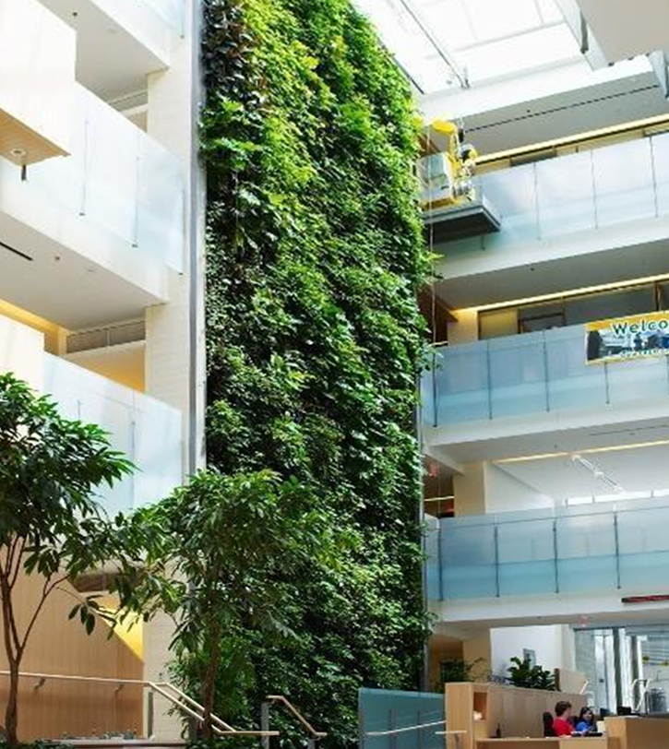
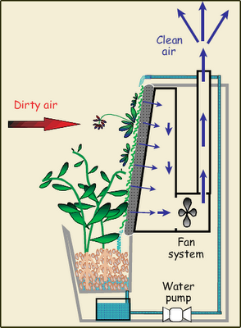
A Word About VOC Removal
Photo Courtesy: Nedlaw Living Walls
Photo Courtesy- Nedlaw Living Walls at Guelph University
Notes:
Plants are natural air conditioners and purifiers. There are many studies which demonstrate that plants and the microbes found in soil media absorb harmful VOCs and convert them into compounds which plants in turn use for food. This phenomena leads to fewer health complaints such as headaches and respiratory irritation, as well as increases in focus and attention.
Among living wall systems one system excels at removing VOCs from indoor air. This is system is the bio-filtration hydroponic living wall system which can be integrated into the building’s HVAC system.
It works like this; air is actively drawn through the plants and the growth media, into the HVAC system and the freshened air is re-distributed throughout the building. This system requires a catch basin and irrigation re-circulation system.
In this system the plant root zone absorbs VOCs such as Benzene, Formaldehyde, Xylene, Acetone, and ammonia to name a few. Photo: Nedlaw Living Walls at Guelph University

Slide 28
Design Fundamentals for Living Walls
Client Objectives
Site Analysis
Access
Light
Water & Pest Control
Plant Palette
Installation
Budget
Exterior Considerations
Photo Courtesy: Green over Grey
Notes:
This is a list of the things to consider as you begin to specify a living wall.
Successful living walls must do three things:
- Allow the plants to grow in a healthy and safe fashion
- Provide irrigation and protect the underlying wall from damage
- Allow for wall maintenance.

Slide 29
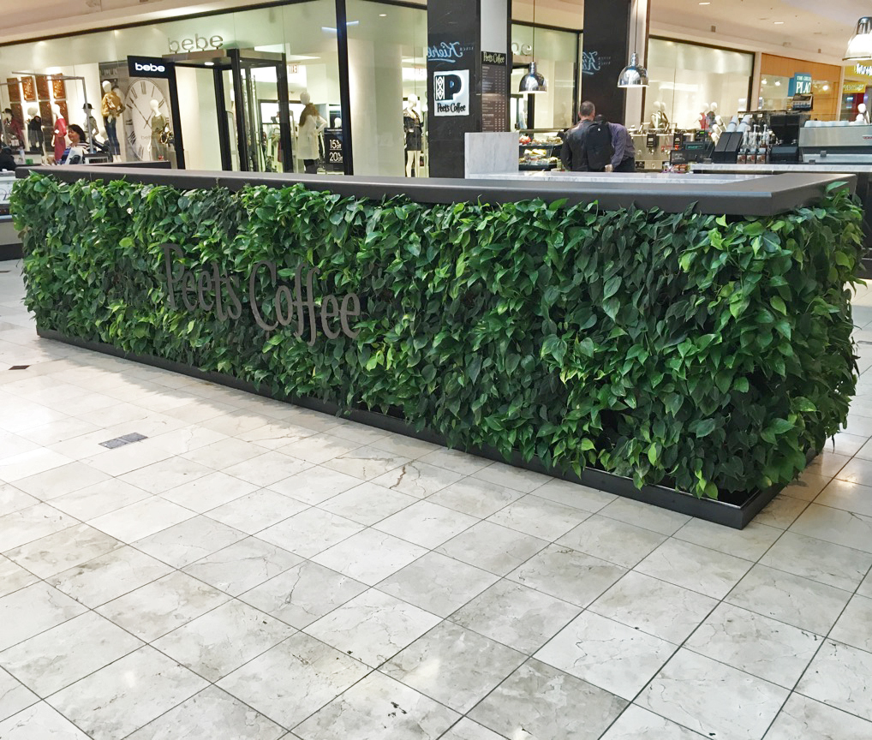
Client Objectives
Biophilia Benefits
Increased retail sales, tenant retention
Increased patient healing rates, decreased medication consumption
Increase property value
Increase worker productivity
Improved Air Quality
Well Building Certification
On-Brand Messaging; green business, emphasis on art & aesthetics, unique
Photo: Cityscapes, Bethesda, MD
Notes:
Step one - Why does the client want the living wall?
It’s probably a combination of things.
This is pot rack system, irrigated with a water tank.
Photo: Cityscapes, Bethesda, MD. This is pot rack system, irrigated with a water tank.

Slide 30
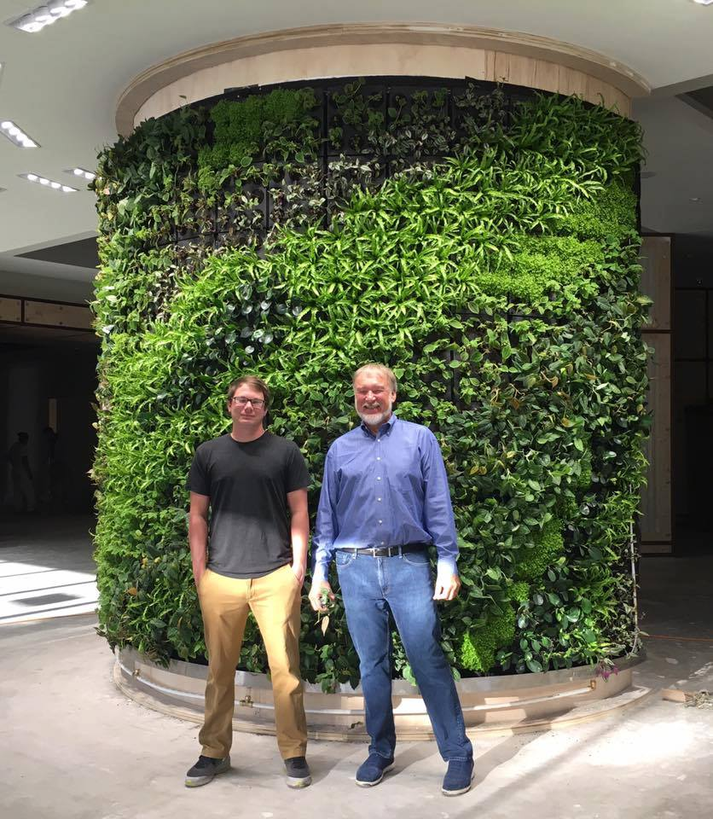
Site Analysis
Building and support structure
New construction or retrofit?
Size of wall
Structural integrity and the weight load
Attachment surface
Photo: SageGreenLife system, installed by Ambius, Chicago, IL
Notes:
Step 2 Where is the living wall being installed?
Structural integrity -
weight capacity- when fully saturated many systems are as low as 10 pounds / sq ft. Some of the systems are as much as 25 pounds/ sq ft.
What will you attach it to?
*attaching to a fence is a bad idea
Photo: SageGreenLife hydroponic modular system, installed by Ambius, Chicago, IL

Slide 31
Access
Utilities
Lighting
Irrigation
For maintenance and replanting
Plumbing and drainage (some systems)
Monitoring of moisture and irrigation systems and equipment
People
Photo: Whole Foods, Boston, MA
Notes:
Design your plan for access to:
Utilities & lighting, maintenance and replanting, irrigation and drainage plumbing for some systems (albeit not all), and equipment for monitoring moisture and automatic irrigation.
This wall is beautiful, floating in mid-air. But it needs to be watered nightly with a scaffold that is positioned over the escalators. This is an example of why you want to work with an interiorscaper experienced in wall design options and solutions.
This is an engineered modular panel system using soil wrapped in landscape fabric. It is not a standard system, and where the excess water goes is a mystery.
Photo: Whole Foods, Boston, MA

Slide 32
Water & Pest Control System
Irrigation Lines To
Green Wall
Irrigation Control Unit (ICU)
Hard Wire Power Supply
Water Filter
Fertilizer Valve
Master Valve
Fertilizer Injector Unit
Metal Security Cabinet
Multi-Zone Installation - Solenoid Valves
Liquid Fertilizer Supply Tank
Water Supply
Notes:
This is a behind-the-scenes look at a living wall irrigation and fertilization system used with modular engineered systems soil systems.
These control systems are usually located between 30 ft – 50 ft from the wall.
One of the advantages of having this type of control system is that if a pest problem develops in the wall, an appropriately registered pesticide is swapped out for the fertilizer and the entire wall is treated without spraying it.

Slide 33
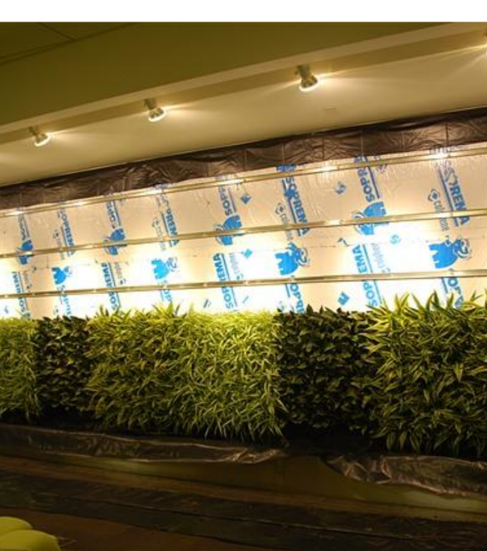
Light
CRITICAL CRITERIA
Intensity: the minimum is 200 foot candles
Temperature: 5,000 – 6,000 Kelvin
Duration: 12 hours/day
Image shows uneven light coverage – designed for failure.
Notes:
Light is the single most important requirement for indoor installations. This image shows uneven light coverage.
Full spectrum lighting must cover the entire wall – from top to bottom
intensity: measured in foot candles or LUX
temperature: measured in degrees Kelvin - 5,700 cool white light
duration: 8-12 hours / day
If there is a large window or other strong light source to the side, the plants will start growing in that direction. It is nearly impossible to grow edibles or succulents indoors. They require a great deal of light to survive and that adds up-front cost, heat and energy use.

Slide 34
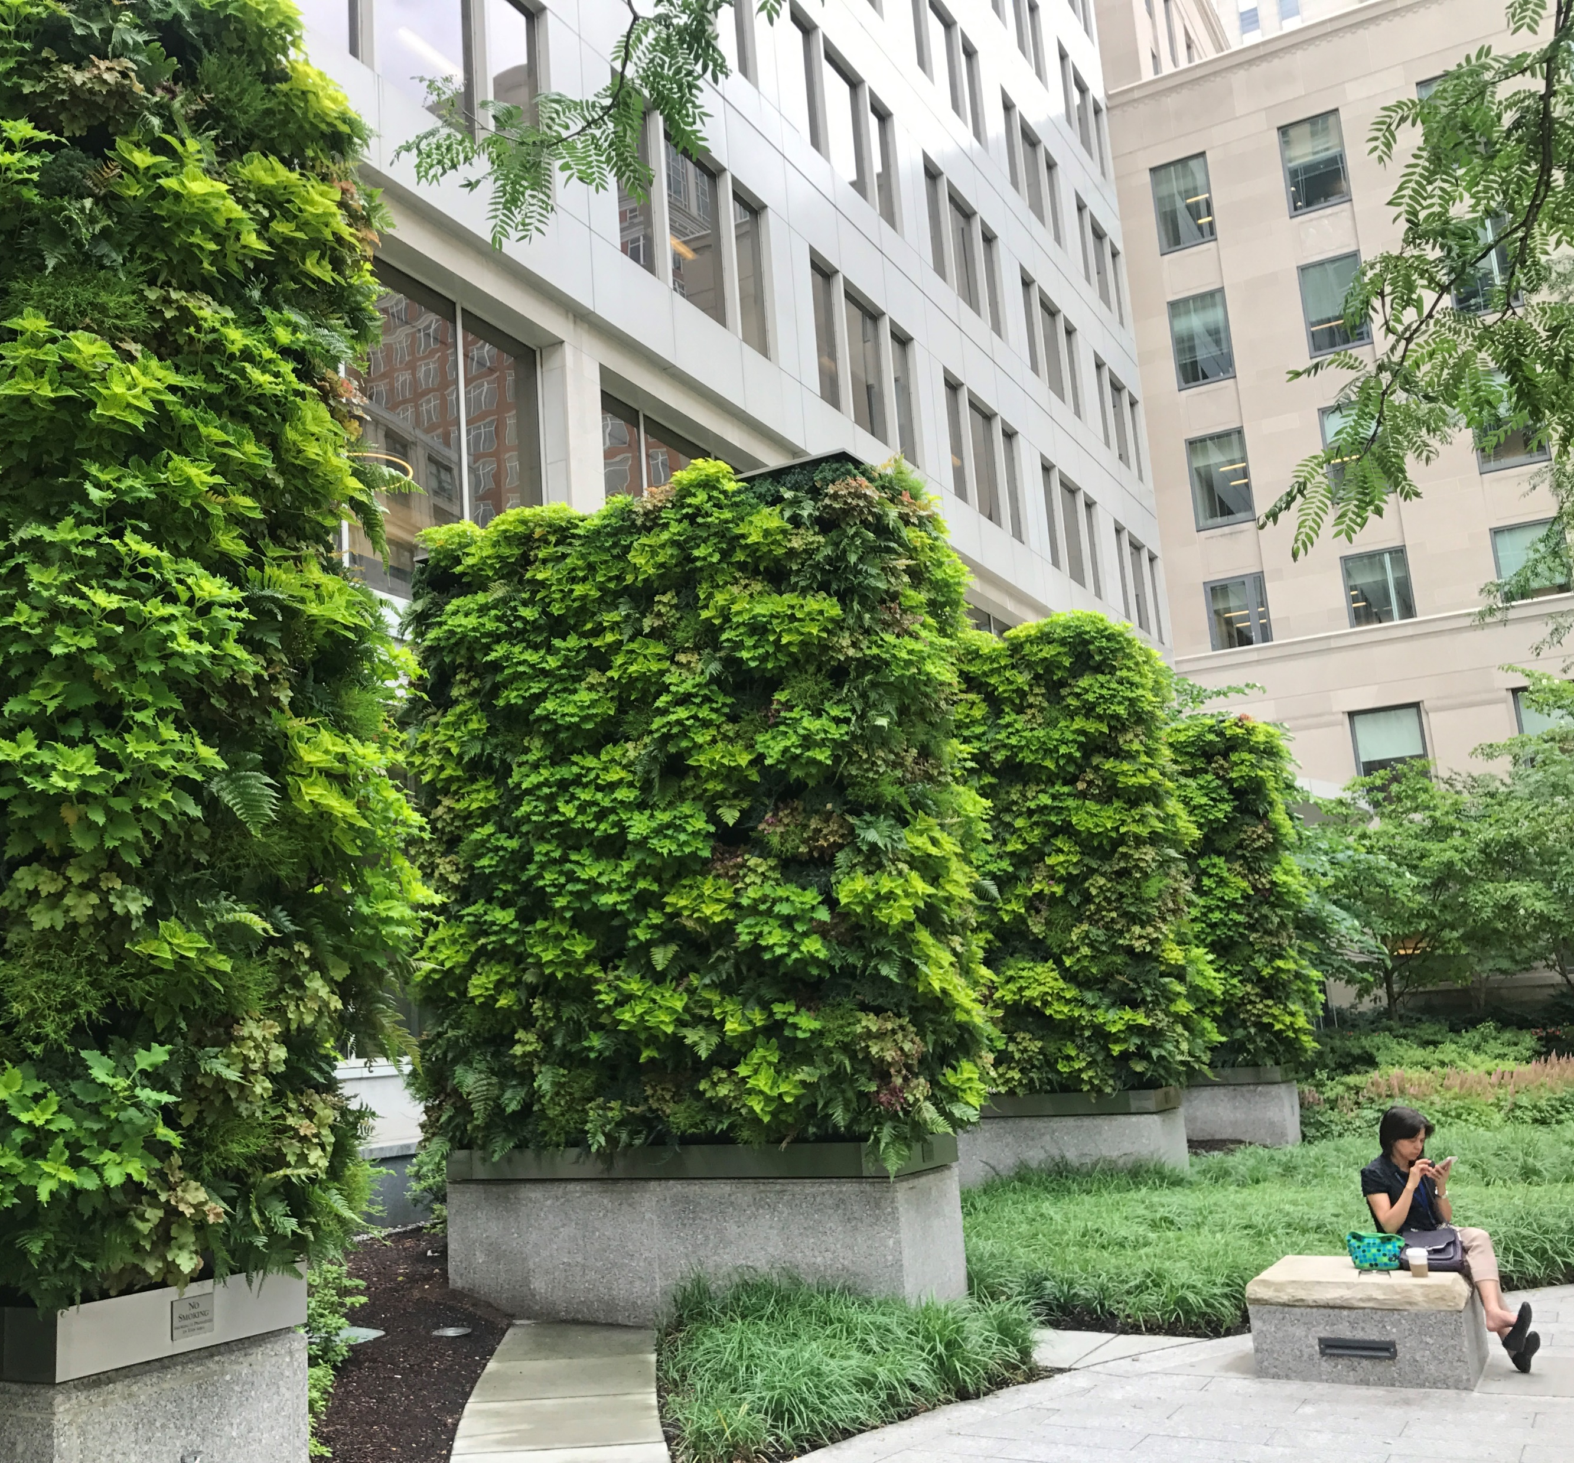
Exterior Specific Fundamentals
Light & sun exposure
Natural light
Artificial Light
Wind and drafts
Irrigation
Temperature range
Precipitation
Photo: Cityscapes, Boston MA, Liberty Mutural buildng
Notes:
Design considerations include sunlight hours, seasonality, orientation to the sun/shade.
Determine prevailing wind direction and intensity. Unlike traditional landscaping, a living wall is exposed to a direct blast of hot or cold wind.
Temperature range – There are methods to keep a living wall alive in climates that get very cold and freeze. Know that black colored systems on a south facing wall can get very hot.
Precipitation patterns – unless rain is blowing sideways, it does not properly irrigate a living wall. Isolate it from the rain gauge.
does it freeze?
Photo: Cityscapes, Boston, MA, Liberty Mutual building

Slide 35
Average Costs for Outdoor Living Walls
Project size:
small | medium | large
$242.00/sf | $193.33/sf | $141.33/sf
$2.06/sf | $1.45/sf | $1.37/sf
Construction cost:
Monthly maint. cost:
Some Variables:
Size (and height) of living wall
Climate and total maintenance visits per year (labor savings typically offset by plant replacements)
Site location and access
Pre-growing vs. planted on-site
Union/prevailing wage, number of subcontractors
Quality of materials – plants and trim, irrigation controls and sensors, etc.
Estimates courtesy of Chad Osborn, SageGreenLife as of 2019.
Notes:
Estimates courtesy of Chad Osborn, SageGreenLife as of 2019.

Slide 36
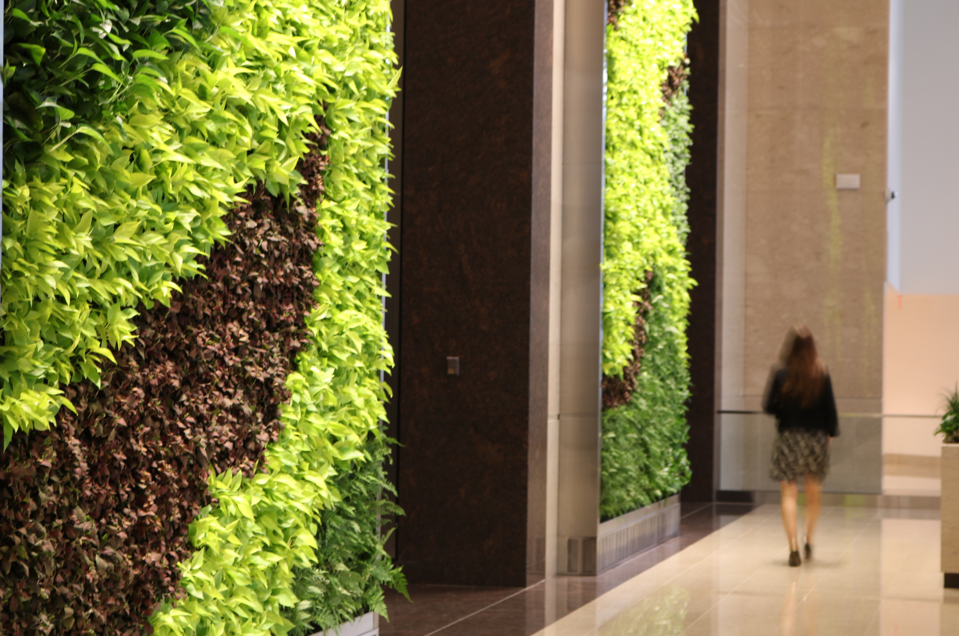
Plant Palette
PLANT SELECTIONS SHOULD REFLECT DESIGN GOALS
Aesthetics
Living art
On-brand messaging
Ambience and relaxation
Food production
Living plant experiences for education programs
Air purification
Photo: Cityscapes, Boston MA, Boston Properties, 100 Federal Street
Notes:
Plant Palette
Plant selection reflects the design goals for living green wall, i.e. aesthetic enhancement, living art, food production, relaxation, air purification.
Environmental factors may limit or inform specific plant choices.
Photo: Cityscapes, Boston MA, Boston Properties, 100 Federal Street

Slide 37
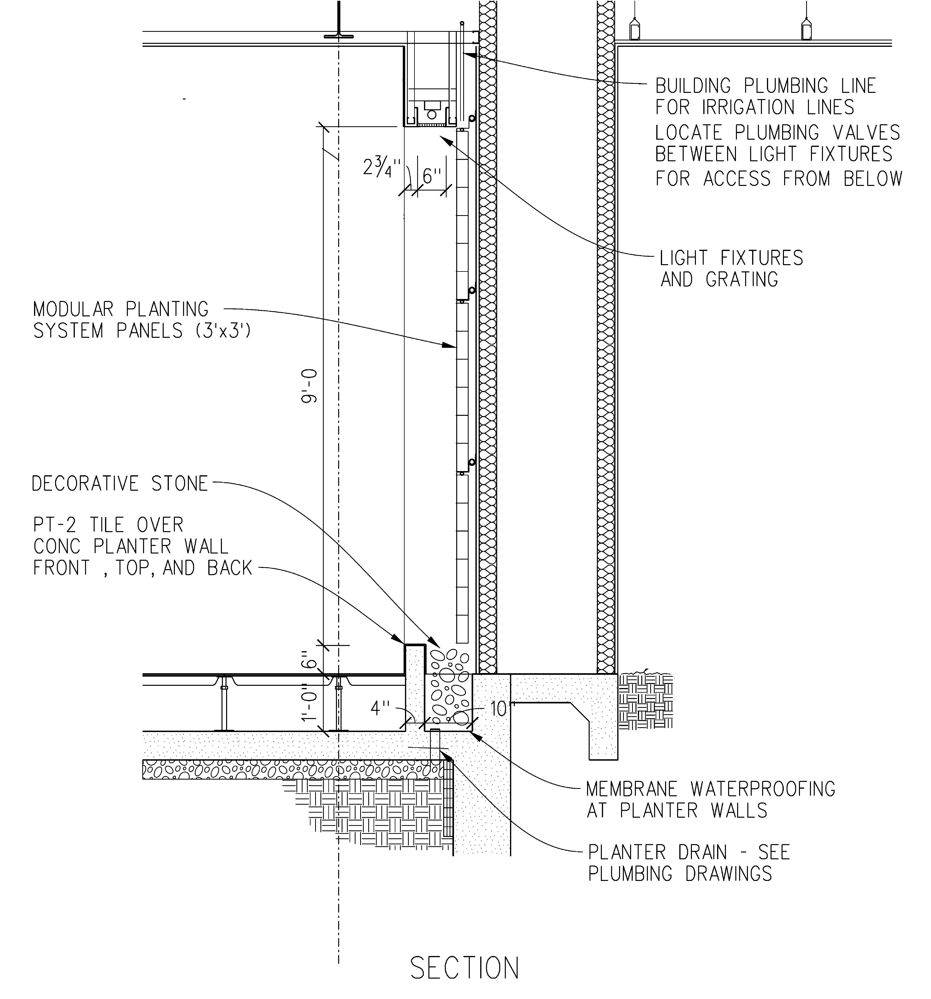
Installation
EXAMPLE OF A MODULAR SYSTEM’S SPECIFICATION DETAILS. ELEMENTS INCLUDE:
Lighting
Waterproof membrane
Drainage catch basin
Irrigation plumbing
Modular planting panels
Notes:
It is critical to include a horticulturalist (preferably the one who will be maintaining the system) in the earliest planning stages of the product to determine the feasibility of the project and advise on the system selection.
Typically, your horticultural professional will install the system in collaboration with the architect and building engineer for a problem-free installation. Together they determine the equipment needs and assure that all involved are well trained for a safe and efficient installation.
Photo: Greenwalls VPS system by McCaren Designs.

Slide 38
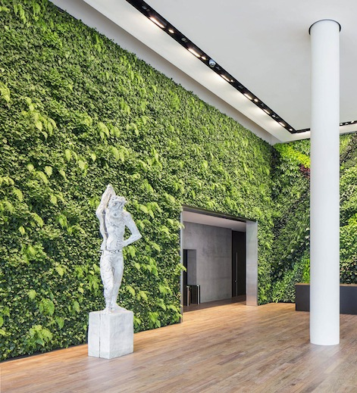
Budget -Installation
INITIAL INSTALLATION VARIABLES
$100 - $200 sq. ft.
Size
System
Access
Scope
Prevailing wage
Complexity
Building & safety codes
Photo: Habitat Horticulture, Foundry Square III, San Francisco, CA
Notes:
Factors affecting the installation budget are:
Size- economy of scale
System – from simple to robust
Access – are lifts and scaffolds required?
Scope- is design required?
Prevailing wage – based upon region and client (municipalities are typically union or prevailing wage jobs)
Complexity of design.
Photo: Habitat Horticulture, Foundry Square III, San Francisco, CA

Slide 39
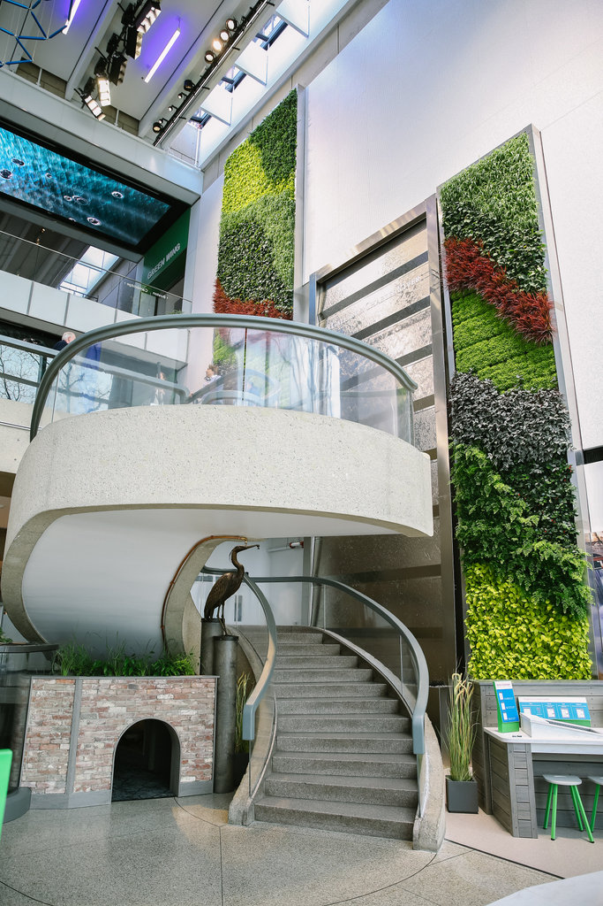
Budget -Maintenance
THIS IS MANDATORY!
VARIABLES INCLUDE
Frequency
Accessibility
Plant warranty
Pattern
Photo: SageGreenLife system at Museum of Science, Boston, MA. Installed by Ambius.
Notes:
Factors affecting the maintenance budget include:
Indoor vs Outdoor
Environmental Factors
Temperature Range
Sun and Lighting
Wind
Budget
Initial install cost
Maintenance- frequency, accessibility, budget. Sometimes, as is true with this organization, on responsibility for wall maintenance can be rolled into the accountabilities of the building maintenance staff. Knowing that this is an objective influences the type systems the client should be considering.
Safety and Building Codes
Photo: SageGreenLife system at Museum of Science, Boston, MA. Installed by Ambius.

Slide 40
Interior Maintenance Estimates
Minimum service per month $150; depends upon the system, size, location, plant pattern
$3 to $6, per sq ft, per month
Or calculated by installation contract amount; 10% to 15% of selling price, per month
Photo: Ambius at George Washington University. System is SageGreenLife.
Notes:
Begin with end in mind! Said another way, design with the maintenance budget in mind.
A maintenance plan must be part of the first discussion when planning to install a living wall. Anytime you have water free-flowing through the plantings there is bound to be some dripping from the plantings themselves that cannot be avoided. A well-designed system has a large catchment system at the base of a living wall that can become a wet surface. In addition to the plants, this needs to be maintained.
Some walls may require a comprehensive, in-depth maintenance plan because of the size of the wall.
Other walls may require simpler forms of maintenance. However, every living wall will require a maintenance plan and this should be considered from the beginning.
Generally the minimum maintenance contract with the install will run from 3 months to a year.
Prices vary widely based upon geography and scope of work. New York City is $11 / sq ft in 2019.
For this installation, to keep maintenance costs down, the maintenance room was built to hold the cherry picker so that the equipment did not need to be transported to the site for the scheduled service. Much easier and less expensive.
Photo: Ambius at George Washington University. System is SageGreenLife.

Slide 41
Case Studies
Photo Courtesy: Green over Grey
Notes:
The prices in these case studies reflect the actual costs of these specific installations’ construction and maintenance.
If you hope to use them as a guideline for your own project, please understand that, in addition to the complexity of the system and design, these costs may vary based on regional differences in wage rates, and the installation date of the case study project.

Slide 42
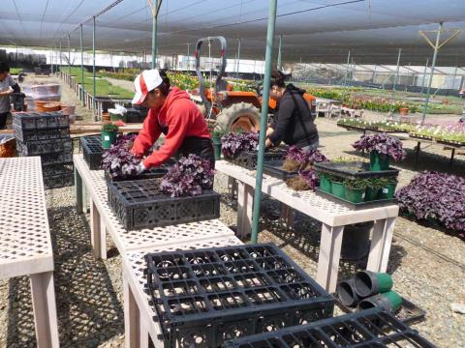
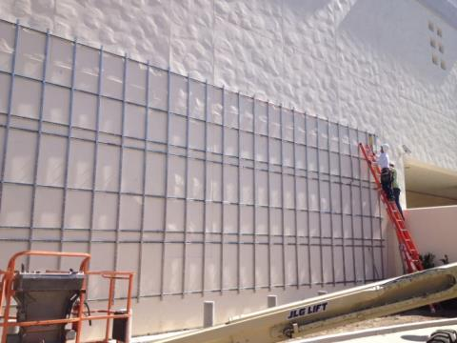
Fashion Valley Mall
San Diego, CA
Installed: 2013
Design: Mission Landscape Architecture
Installation: Greenscaped Buildings
Product: 250 VGM recycled plastic modules on SS rails, mounted on unistrut
Size: 800 sf
Utilities: irrigation equipment off to side, French drain behind hedge below
Pre-Planted: in nursery, approx. 3 months prior
Plants: Chlorophytum comosum, Lysimachia nummularia, Ophiopogon japonicus 'Nanus‘, Ajuga reptans, Pteris sp., Heuchera sp.
Construction cost: $ 125,000 (approx), Roughly $150/sf
Maintenance cost: Roughly $1.75/sf
Notes:
Design intent: new area in mall, replacing a little-used parking lot with public area. Living wall added to soften space, make more inviting
Pre-planted off site for 3 months prior to installation
Unistrut was used to create a horizontal line of connection, attaching to studs in the wall

Slide 43
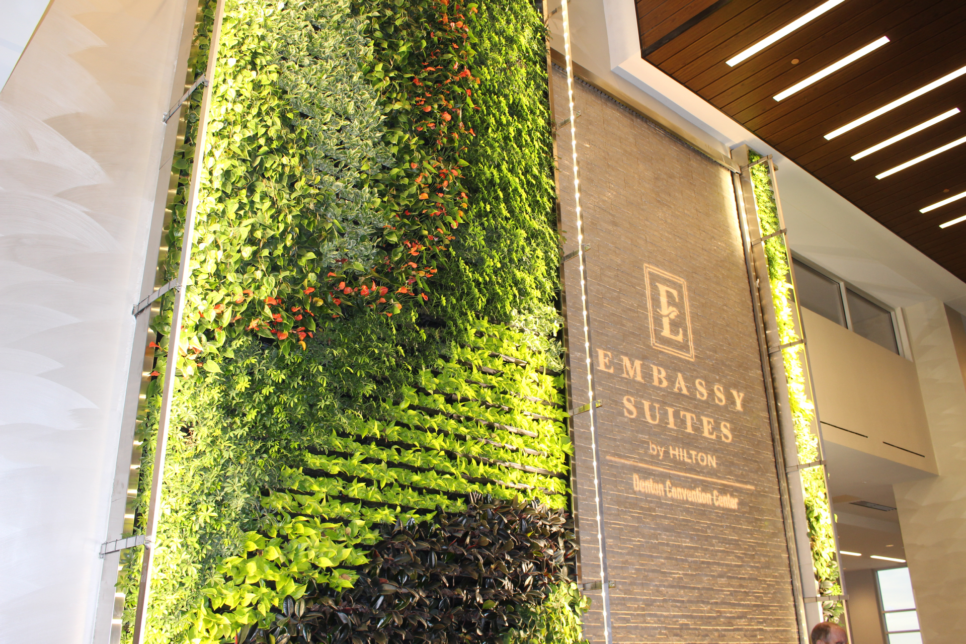
Embassy Suites
Denton, TX
Installed: 2017
Design: Debbie Kotalic
Installation: Natura
Product: Gsky Versa Wall
Size: 298 sf
Utilities (water supply & drainage): Municipal supply, ICU (irrigation control unit) below the wall, Direct drain (drains to a built-in sewer system)
Planted: On-site
Plants: Philodendron cordatum, Neon pothos, Schefflera luseane, Ficus elasica burgundy, Pearls & Jade pothos, Anthurium Fiesta Red
Construction cost: $ 43,000, $144.00/sf
Maintenance cost: $635/mo, $2.13/sf

Slide 44
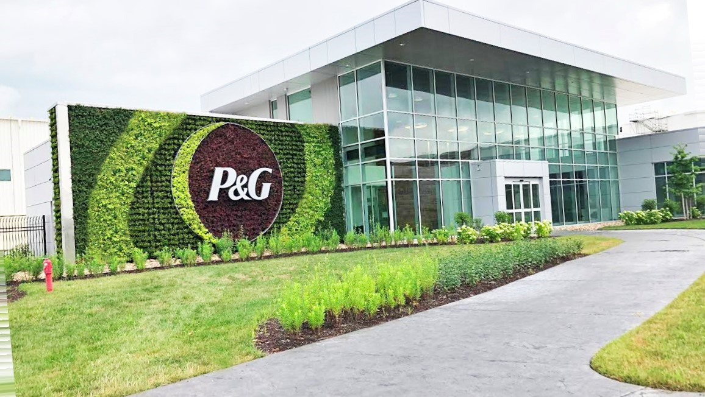
Proctor & Gamble Resource Center
West Virginia
Installed: 2018
Design: Debbie Kotalic
Installation: GSky
Product: Gsky Versa Wall XT
Size: 906 sf
Utilities (water supply & drainage): Municipal supply, remote ICU (irrigation control unit), Free drain (drains to soil)
Planted: On-site
Plants: Crimson Pigmy Dwarf Barberry, Gold Pigmy Dwarf Barberry, Boxwood - Wintergreen, Dwarf Nandina Fire Power, Cotoneaster Demmeri Coral Beauty
Construction cost: $98,000., $1.08/sf
Maintenance cost: $1150/mo, $1.26/sf

Slide 45
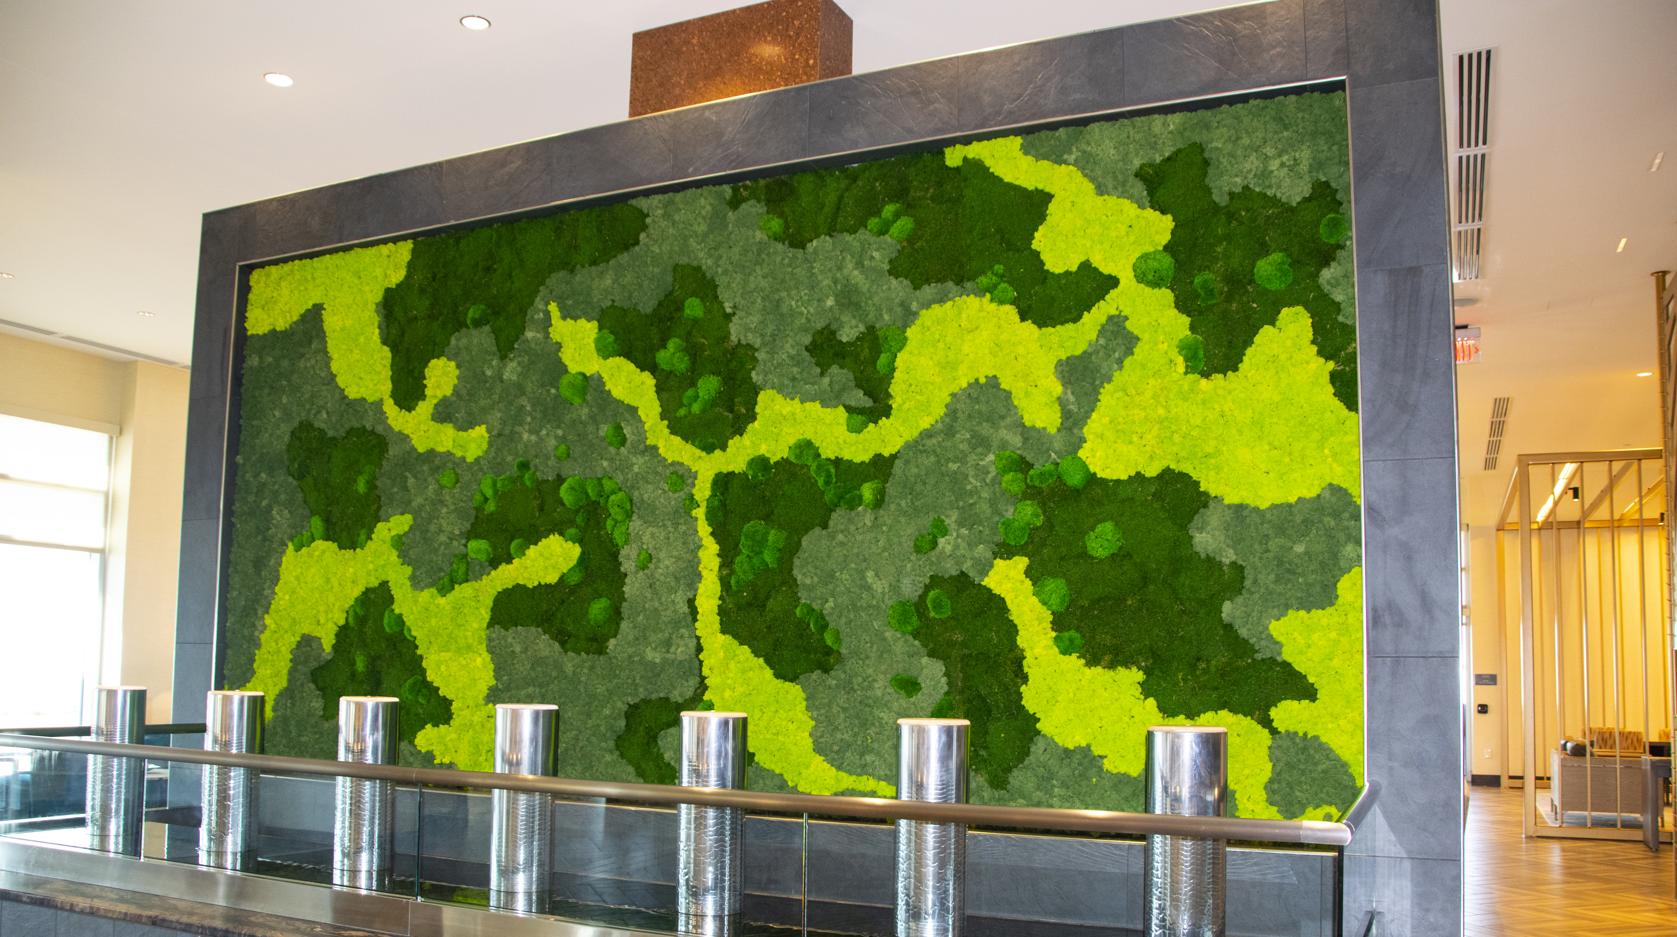
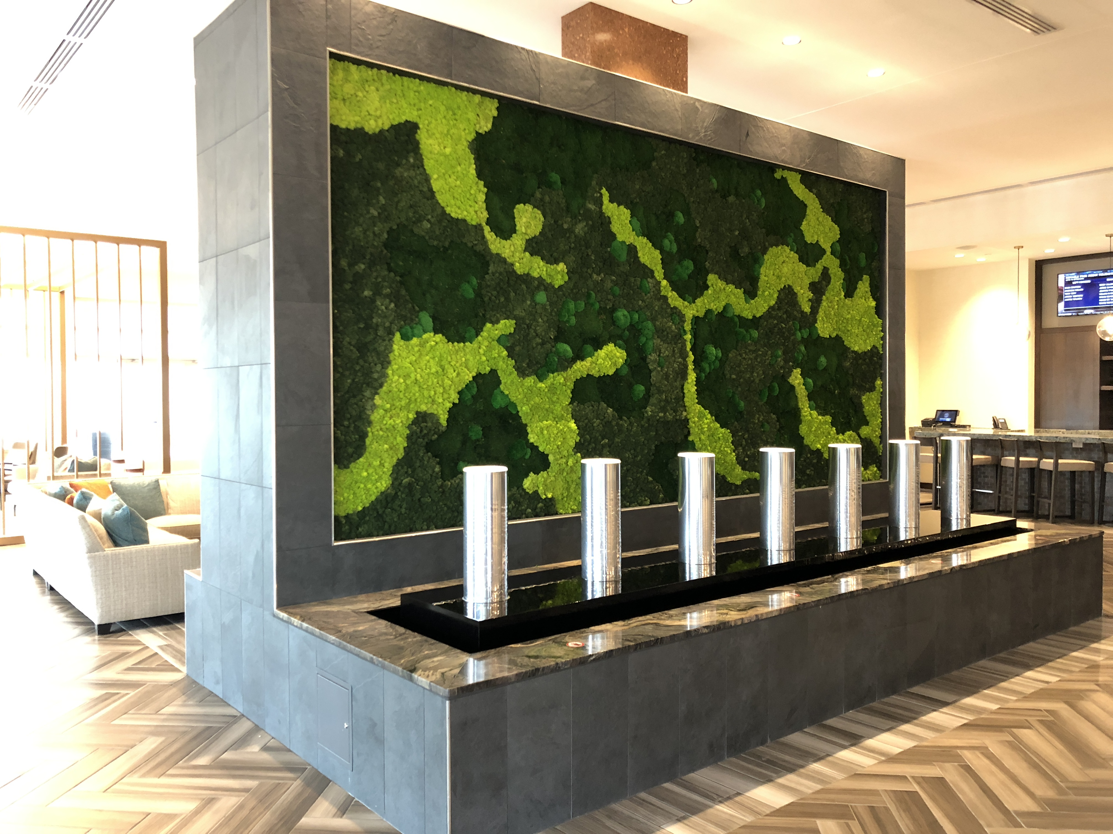
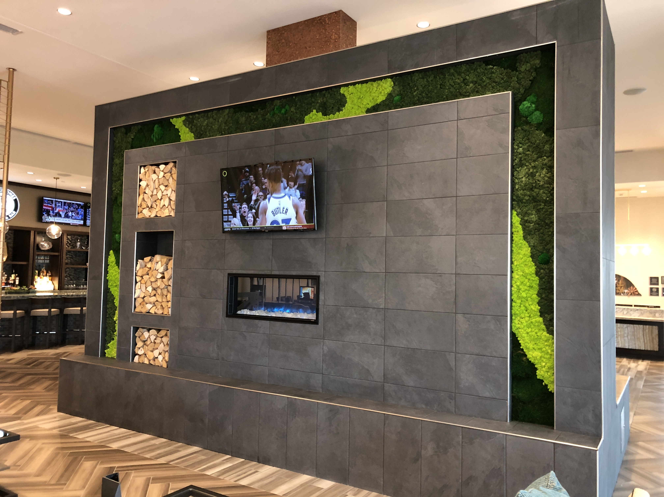
Embassy Suites – Landmark Center
San Antonio, TX
Installed: 2018
Design: Natura
Installation: Natura
Product: Natura
Size: 165 sf
Utilities: None
Fabricated and Planted: Offsite
Moss Varieties: Spring green and dark green reindeer moss, pole moss, dark green sheet moss.
Construction cost: $20,790. - $126/sf
Maintenance cost: None
Notes:
Design intent: to create focal point / backdrop for fireplace, flatscreen and function as a room divider. Water feature is installed in front of the wall.

Slide 46
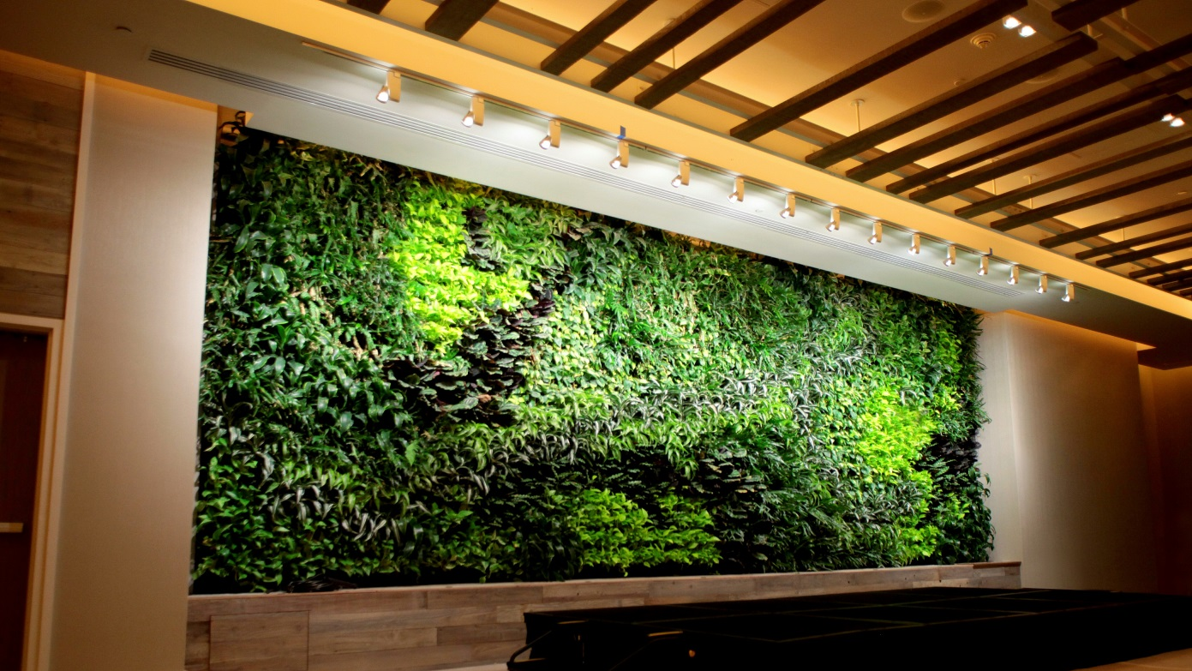
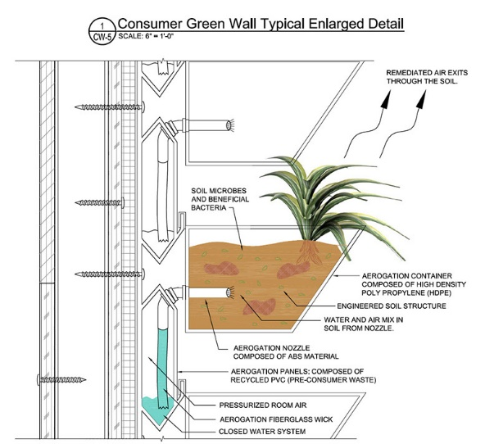
1 Hotel
South Beach, FL
Installed: 2/15/2015
Design: Mark Prescott
Installation: Agrosci
Product: Aerogation active green wall system by Agrosci Inc
Size: 35’ by 12’
Pre-planted off site
Containers – not removable
Construction: $65,000.
$155.00 / Sq Ft
Notes:
Criteria: active system cleans 200 cubic feet / minute digesting odors, VOCs, and particulates
Design intent: soften ball room by adding a natural element, improved air quality for large functions and groups of people
System can remove 62% of the nitrous oxide (NO2 - diesel fumes) in a single pass

Slide 47
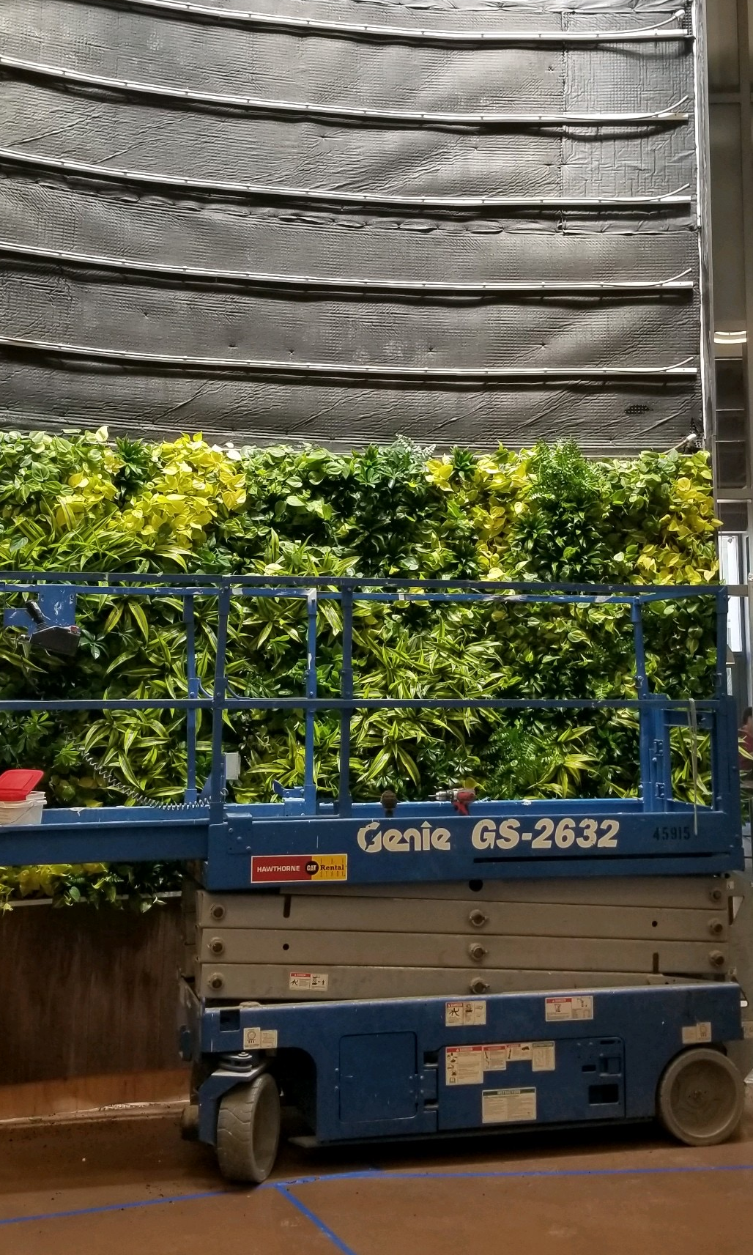
655 West Broadway
San Diego, CA
Name of Project: 655 West Broadway
Installed: January 2020
Designed & installed by: SageGreenLife, Michele Arnold Kush of Safdie Architects, and GreenScaped Buildings
Product: SageGreenLife Biotiles
Size: 300 sq ft
Utilities: irrigation components located in garage one floor below. Includes remote sensors and drains to sewer. Supplemental lighting provides 150+ foot candles over entire wall.
Planted Pre-planted Biotiles were grown off-site for 4 months.
Plants: 1972 plants used. Lemon lime dracaena, Schefflera arboricola, Dracaena compacta, Neon pothos, Austral gem ferns, Dracaena warnekii, Cordatum philodendron.
Construction : $65,000 - $227/sq ft
Maintenance : $900/mo or $3.15/ sq ft
Notes:
This wall is curvilinear on a concave radius. This shows up a little more clearly in the construction picture.

Slide 48
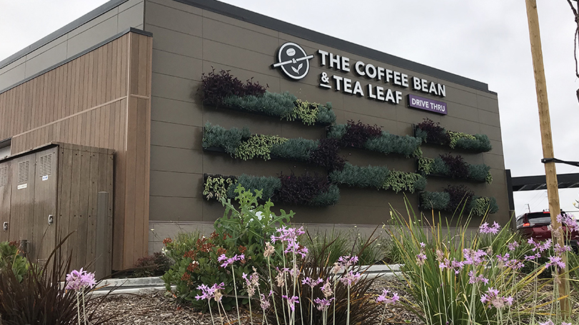
Coffee Bean & Tea Leaf
Brea, CA
Name of Project: Coffee Bean and
Tea Leaf
Installed: October 2018
Designer: Lyons Warren
Installed by: Elevation Vertical Gardens & Living Walls, Inc.
Product: Varden
Size: 168 sq ft composed of eight 10’x1.5’ floating panels
Utilities: Drip irrigation with 6” spacing, custom catch basins.
Planted: Planted onsite.
Plants: Tradescantia pallida, Senecio mandraliscae, and Sedum morganianum.
Construction : $17,817 - $106/sq ft
Maintenance : $300/bi-monthly or $3.57/ sq ft

Slide 49
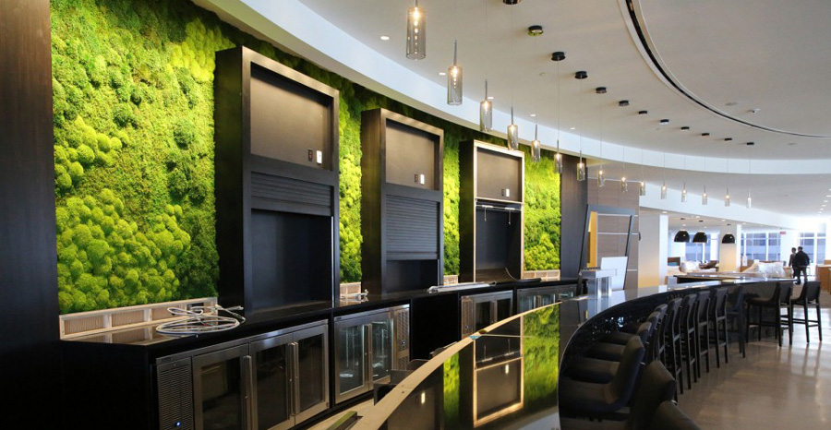
Thank you!
How to receive your CE credit
Photo: Artisan Moss, Hilton Bar, Cleveland, OH
Notes:
Photo: Artisan Moss, Hilton Bar, Cleveland, OH
Thank you so much for inviting me to share this information with you.
Are you receiving continuing education credit for today’s program?
Be sure you have signed the registration roster and completed your program evaluation.
Upon receipt of your program evaluation, you will receive a certificate of course completion.
Other resources are available on www.gpgb.org.

Slide 50
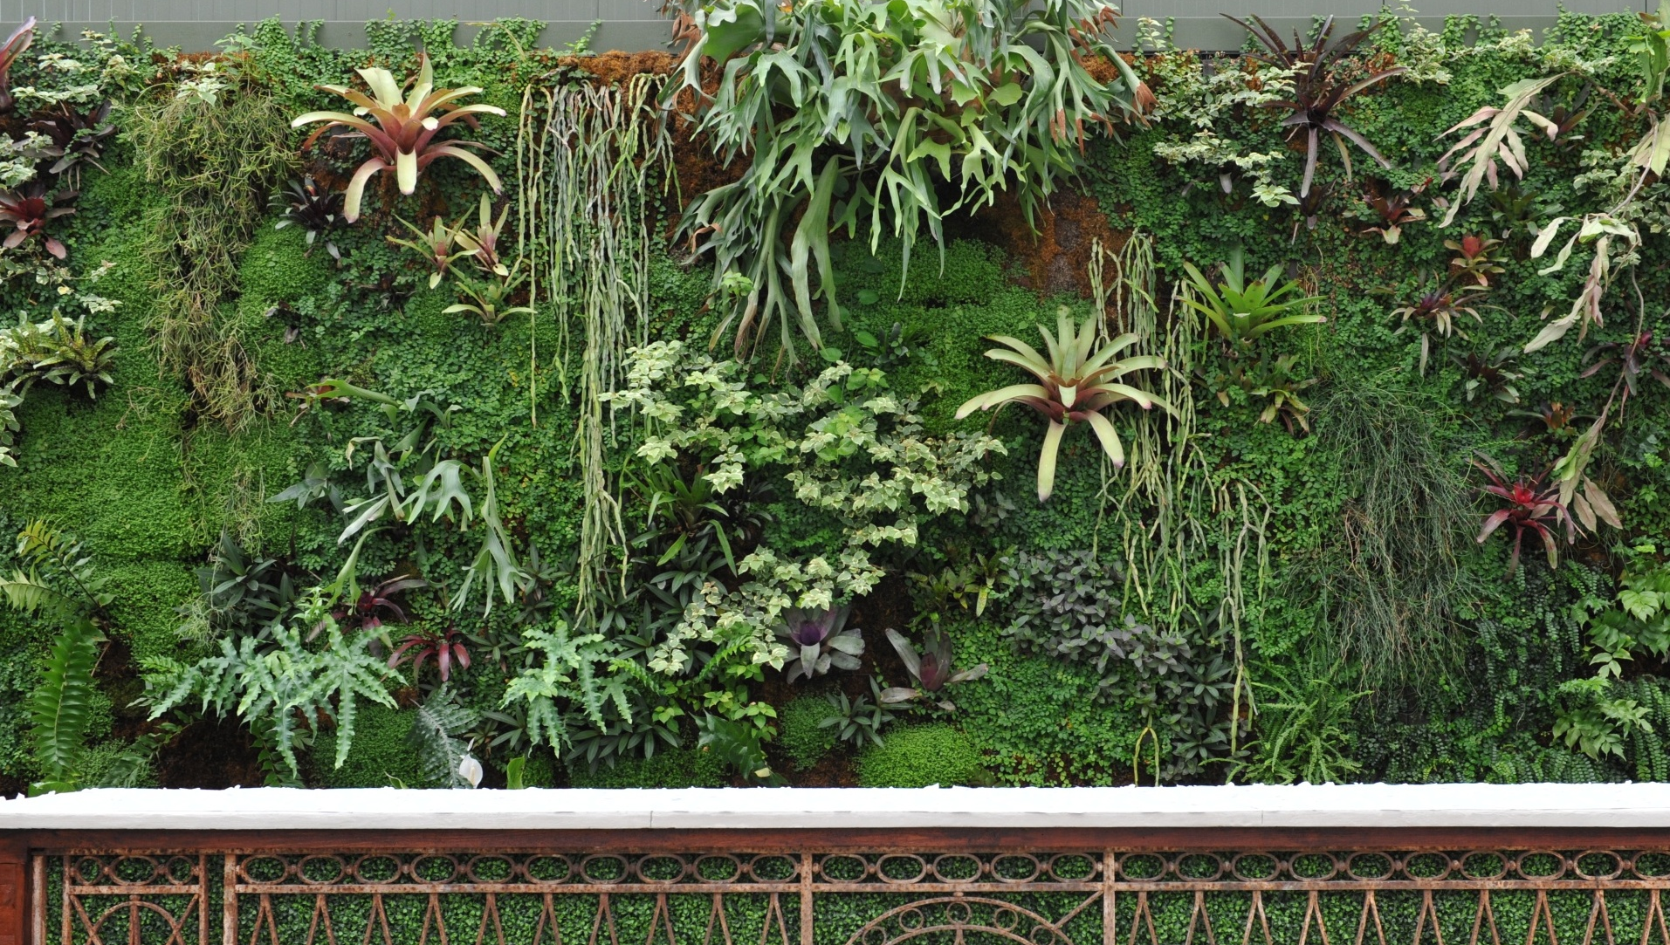
Looking for more Continuing Education?
Authentically Green Interiors – Optimizing Nature’s Design
Moss Walls – A Biophilic Design Solution
Green Roofs
The Economics of Biophilic Design
Biophilic Design in Fitwel, WELL, and the
Living Building Challenge
Learn more or donate at gpgb.org.
Photo: Shane Pliska, Planterra. Location: Planterra, West Bloomfield, MI
Notes:
Photo: Shane Pliska, Planterra
Location: Planterra, West Bloomfield, MI

Slide 51
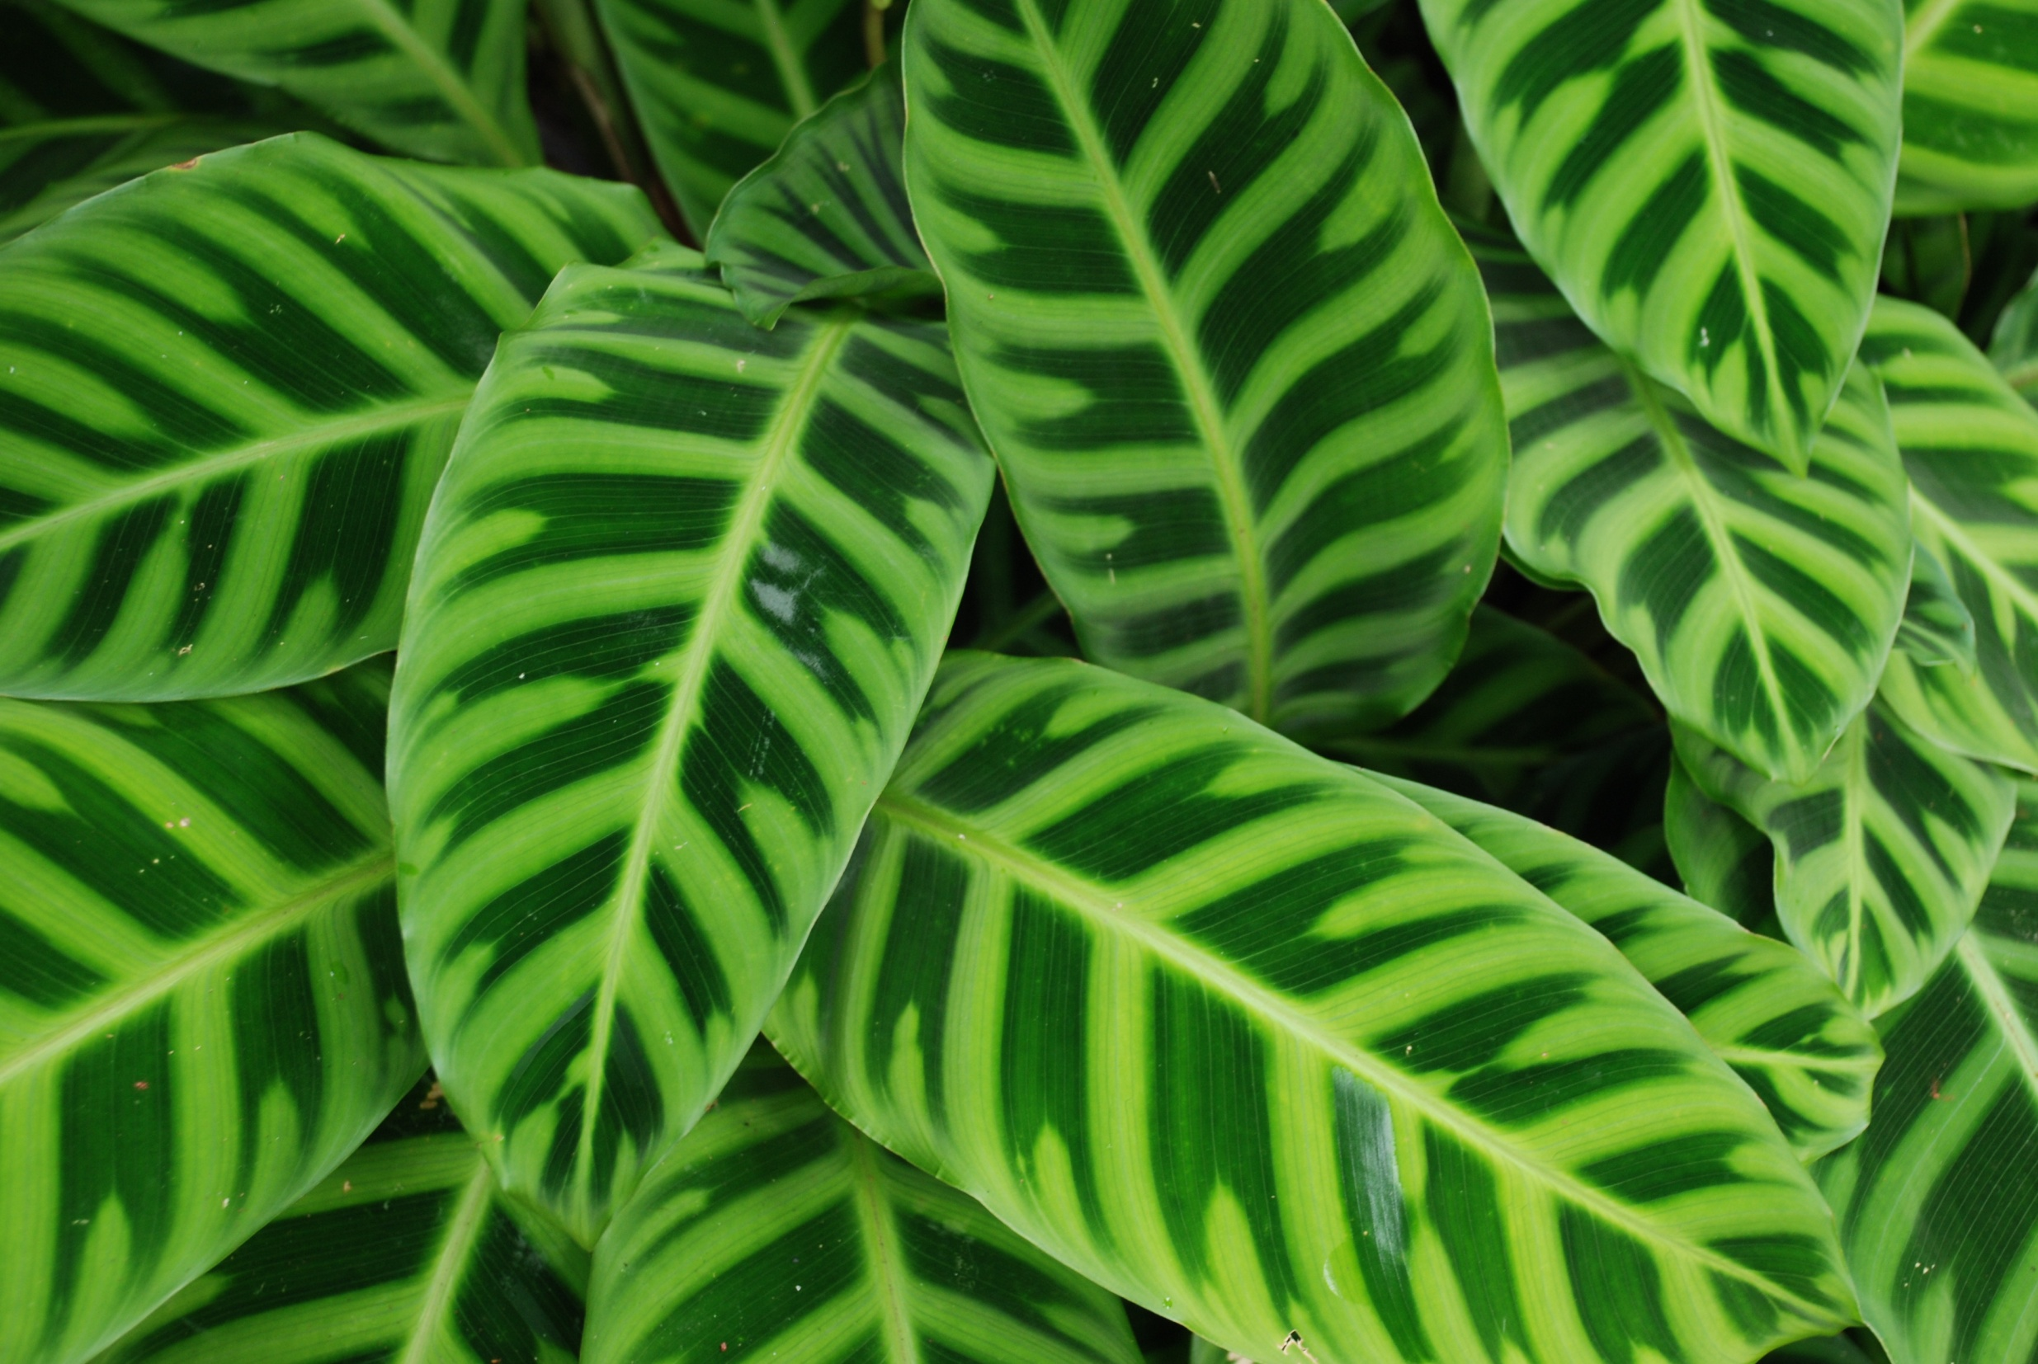
Expanding our marketing conversations
Wellness matters!
Let’s put more plants into
human spaces

Slide 52
Add information about your company here.
Project slides
Scope of services
Awards you have won
Professional credentials
Notes:
Add compelling information about your company to this slide.
Switch the slide image to a memorable image that represents your company’s professionalism and status as an industry thought-leader.

